Slide 1
Estonia. Smart solutions for education innovation

Slide 2
Estonia
population: 1.3 million
45,339 km2
EU, NATO member (since 2004)
99% of public services online

Slide 3
Estonian students rank #1 in Europe (PISA 2018)
4th
5th
8th
in the world in science
in the world in reading
in the world in math
3 times more
top performers (15.5% vs OECD 5%)
The lowest number
of low performers
(8.8% vs OECD 22%)

Slide 4
How did we get there?
EDUCATIONAL MINDSET It has always been both a guarantee of individual success and one of the main drivers of the country's development.
DIGITAL SOCIETY In a country where 99% of state services are online and people trust e-society, we use the possibilities of technology in education as well.
CAN-DO ATTITUDE Over the last 30 years, Estonia has implemented a lot of large-scale educational reforms, doing it „the Estonian way“ - quickly and boldly.
INNOVATIVE START-UP CULTURE State has supported entrepreneurship education for decades. Past years have seen rapid growth in the EdTech sector.

Slide 5
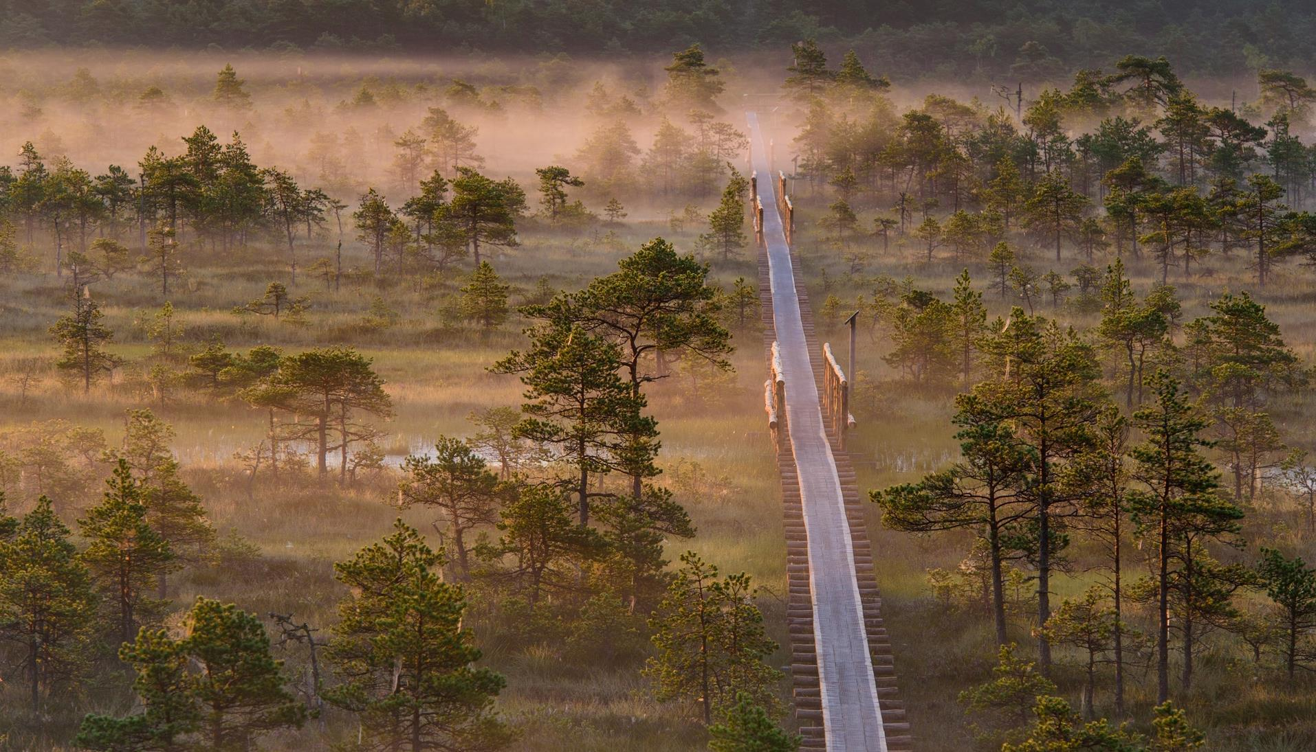
Education has been highly valued through generations
Before 1918
Under Danish, Swedish, German, Russian rule
13th c. First monastic schools
17th c. Schools for peasant children
1860-70s Compulsory school
1881 Literacy rate 94%
1918-1940
Estonian Republic
1944-1991
Soviet Occupation
Start of the Estonian national education system.
From 1920 compulsory and free education for 6 grades.
Estonia managed to maintain high-quality teaching and learning in Estonian.
1991
Republic of Estonia
The modernisation of Estonian education begins.
Notes:
EDUCATIONAL MINDSET. It has always been both a guarantee of individual success and one of the main drivers of the country's development.
Literacy rate - ability to read was one of the highest rates in the world at that time and triple compared to the average in Russian empire. "Compared with the huge Russian empire, to which Estonia belonged at the time, the level of literacy here was immeasurably higher: according to the 1881 census, 94 per cent of the population could read and 48 per cent could read and write." Estonica.org
Work hard and aim high mindset is still prevalent among Estonian students. Estonian students exhibit the largest growth mindset - 77% (OECD average 63%), (PISA 2018). Majority of students diagreed that “Your intelligence is something about you that you can’t change very much“. www.oecd.org/pisa/growth-mindset.pdf

Slide 6
Restart of the education system
VOCATIONAL EDUCATION REFORMS start build a flexible and practical system relevant to the needs of the labor market
EXTERNAL QUALITY ASSURANCE of education
LANGUAGE IMMERSION
PROGRAMME
to foster bilingualism
1992
1996
1999
2001
1994
1997
2000
NATIONAL CURRICULUM
for general education with the focus on learning outcome, decentralisation, and school autonomy
All SCHOOLS CONNECTED TO THE INTERNET and provided with computers
THE LAW ON EDUCATION of the Estonian Republic sets general principles
1999-2009
Harmonising HIGHER EDUCATION with European standards:
recognition of diplomas
3 main study cycles
scholarships for mobility
accreditation system
internationalisation
ENTREPRENEURSHIP becomes a key topic in Estonian education:
1992 student companies
2011 entrepreneurship as a key competence in curricula
2016 Edu ja Tegu programme
TIGER LEAP programme provided schools with computers, internet access, and teacher training. The programme also laid the foundation for a successful
PUBLIC-PRIVATE PARTNERSHIP in Estonian education.
Notes:
The TIGER LEAP PROGRAMME started the digitalisation of the entire public sector in Estonia. In few years, Estonia became the first country in Europe to provide stable internet connection to all schools. www.educationestonia.org/tiger-leap/
The NATIONAL CURRICULUM for general education has been updated regularly afterwards (2002, 2011, 2014)

Slide 7
E-SCHOOL -
web application for schools provides an easy way for parents, teachers, and pupils to share information
Requirement to DIGITIZE ALL LEARNING MATERIALS by 2020
2015-2022
MODERNISING INTERNET CONNECTION in all schools
Future skills forecasting programme OSKA is launched to better connect the education system with the expectations of the labour market
FREE LUNCH in basic school, starting from 2014 also in upper secondary school
Optimising school network:
building of regional STATE GYMNASIUMS begins
2004
2005
2010
2014
2002
2006
2011
2015
INCLUSIVE EDUCATION
as a leading principle
LIFELONG LEARNING STRATEGY 2020: with a DIGITAL FOCUS and a lot of emphasis on IN-SERVICE TRAINING on teachers and school leaders professional development
Establishment of Rajaleidja
SUPPORT CENTRES NETWORK
with offices in every county
PROFESSIONAL STANDARDS FOR TEACHERS create the conditions for systemic teacher education responsive to the needs of society
More variability to educational landscape: changes in school funding principles make
the establishment of
PRIVATE SCHOOLS easier
A state database EHIS brings together all information related to education in Estonia

Slide 8
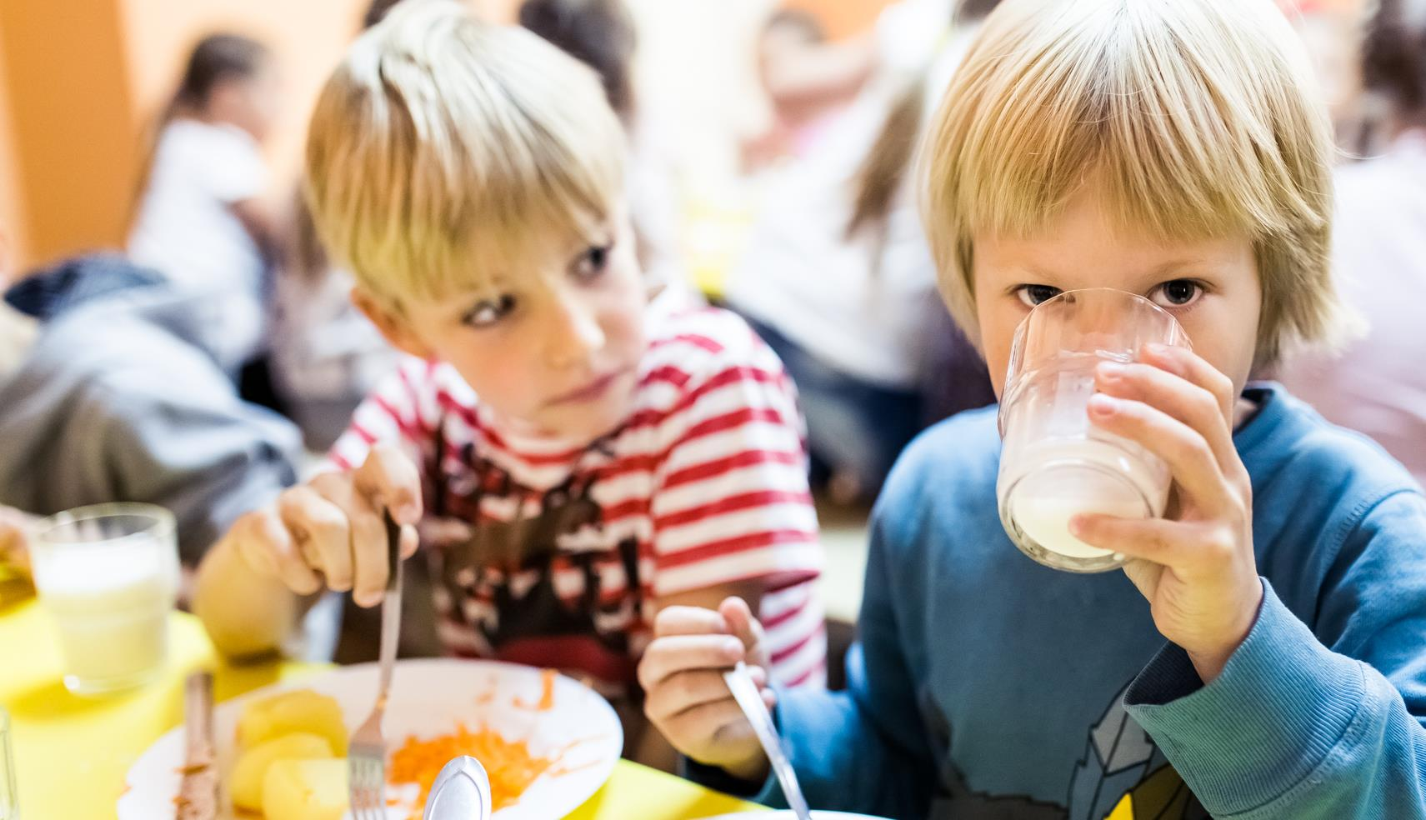
Everyone has the right for a high quality education
In Estonia, student’s socio-economic background has a low impact on performance (6.2 % of variation compared to 12% in OECD)

Slide 9
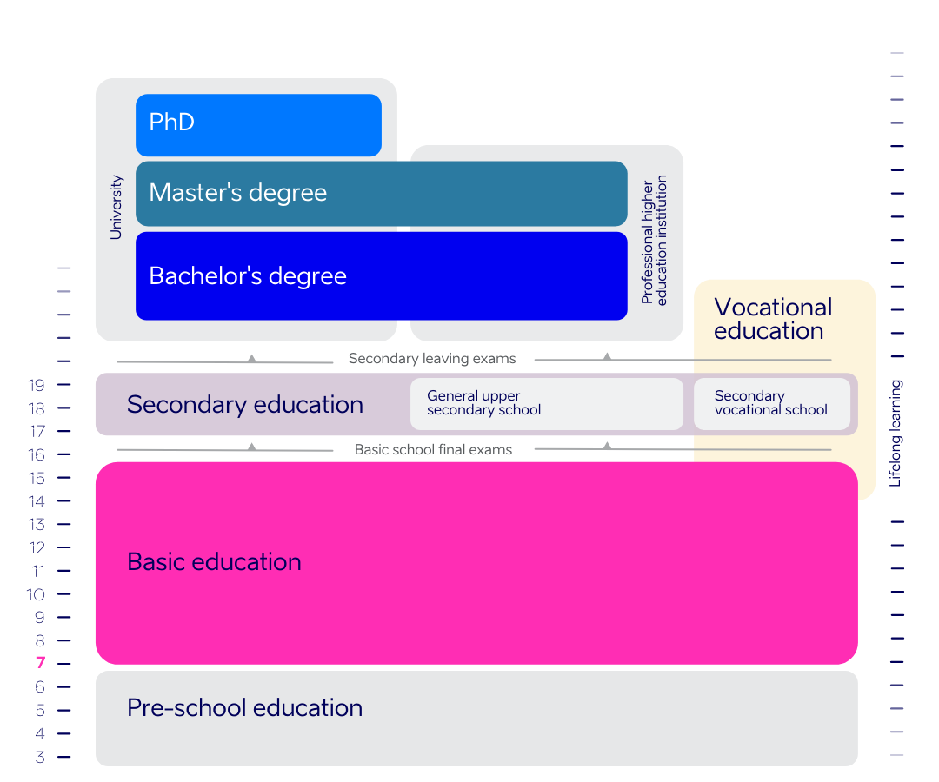
Estonian education today
General education:
156,786 students
16,569 teachers
517 schools
Notes:
Basic education is minimum compulsory general education. Compulsory education starts at the age of seven and lasts from grades 1 to 9.
In general education, schools are mostly run by local governments. There are ≈ 11% of private schools in Estonia.
In both cases, the number of students is used to calculate the amount of state subsidies allocated for covering expenses on teachers’ salaries, training and textbooks.
Pre-school education: 66,979 students, 8012 teachers, 597 pre-school institutions
Vocational education: 25,862 students, 2,086 teachers, 37 schools
Higher education: 44,611 students, 18 educational institutions offering higher education in Estonia
Data: haridussilm.ee 2021/22

Slide 10
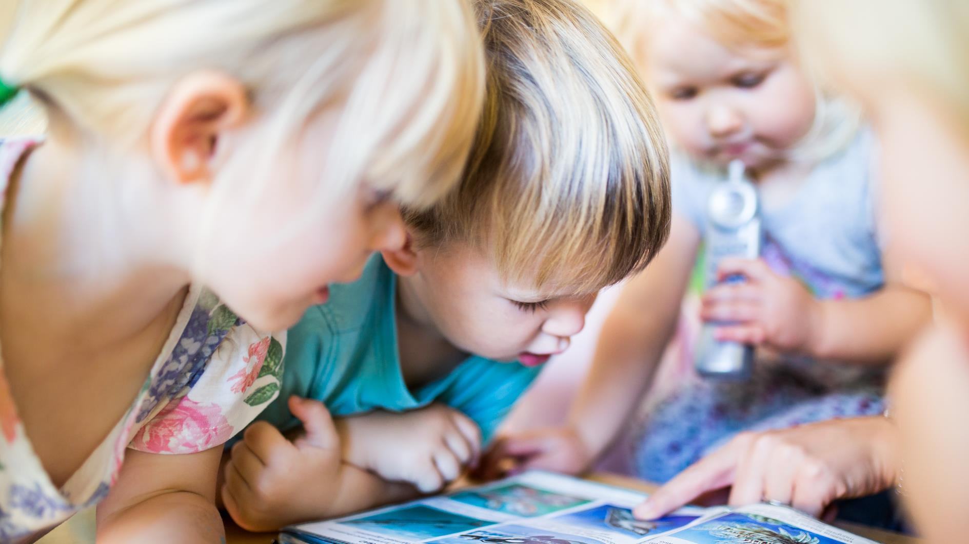
Preschool: preparing for school
94% of 4-6-year children attend kindergarten, though this is not compulsory in Estonia
Curriculum-based learning outcomes are achieved by learning-through-play method
Notes:
10

Slide 11
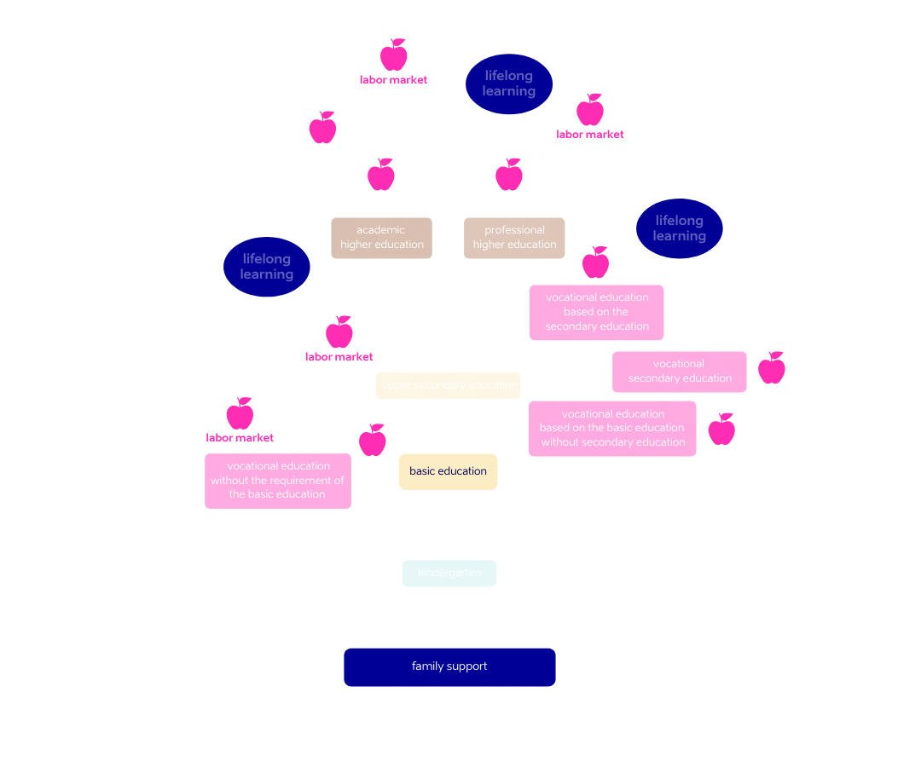
The strength of the tree depends on its roots
No matter which path you have started on, you have the possibility to move on
from one branch to another.

Slide 12
Characteristics of Estonian education
Estonia has sucessfully implemented an INCLUSIVE EDUCATION SYSTEM. Students with different abilities study together.
EDUCATION IS FREE-OF-CHARGE from basic to the higher education. School meals, textbooks, and transit are free for all students.
TEACHERS ARE HIGHLY EDUCATED. A teaching qualification requires the completion of a Master's degree.
Schools, principals and teachers have A LOT OF AUTONOMY.
EXTERNAL EVALUATION of learning outcomes gives valuable feedback.
All students are entitled for free SPECIAL SUPPORT by psychologists, speech therapists at school or at the counselling centres found in every county.
HOBBY EDUCATION offers wide opportunities for self-development in music, sports, art, technology, etc.
STUDY AND HOLIDAYS ARE IN BALANCE: School day and school year are shorter than in many other countries.
Notes:
AUTONOMY: Every school creates their own curricula on the basis on national curriculum. principals can decide on teachers salaries and how the money is spent etc, teachers are free to decide how they reach learning outcomes set in curricula
FUNDING: In general education, the state subsidy is related to the number of students, and covers expenses on teachers’ salaries, training, textbooks etc. Similar subsidies are also made available to private general education schools as prescribed by the Private Schools Act. Private schools comprise 11% of all schools.

Slide 13
Technology opens up new possibilities
The Tiger Leap programme in the 1990s provided schools with INTERNET CONNECTIONS, COMPUTERS, and IT TRAININGS.
Many schools and kindergartens have EDUCATIONAL TECHNOLOGISTS - technology integration specialists to support teachers.
DIGITAL LEARNING MATERIALS are available for all subjects and across all educational levels.
All schools in Estonia use E-SOLUTIONS.
For the evidence-based decisions, the EDUCATIONAL DATA is publicly accessible on the internet.
DIGITAL COMPETENCE is set in curriculum as a general competence throughout all the subjects.
Educational programmes create INTEREST IN TECHNOLOGY from kindergarten to university.

Slide 14
Preparing for the information society
95%
1st
of schools
use e-diaries
in digital learning (CEPS 2019)
99%
9%
40%
of Estonian kindergartens
take part in technology education programme ProgeTiger
of students study ICT in Estonia – twice as many as EU average
(Eurostat)
of ICT university students are female – this is highest share in Europe (Informatics Europe)
Notes:
99% of kindergartens and 98% of schools took part in ProgeTiger programme, Education and Youth Board 2020
8.86% of all students studied ICT (BA+MA) in Estonia, while EU average is 4.65%, Eurostat 2018
2018/2019 38.8% of ICT Master students were female in Estonia, www.informatics-europe.org
1st in digital learning - CEPS (Centre for European Policy Studies) assessed European countries’ performance in digital learning and found that Estonia, the Netherlands and Finland excel in the digitalisation of education. www.educationestonia.org/estonia-no-1-in-europe-for-digital-learning/

Slide 15
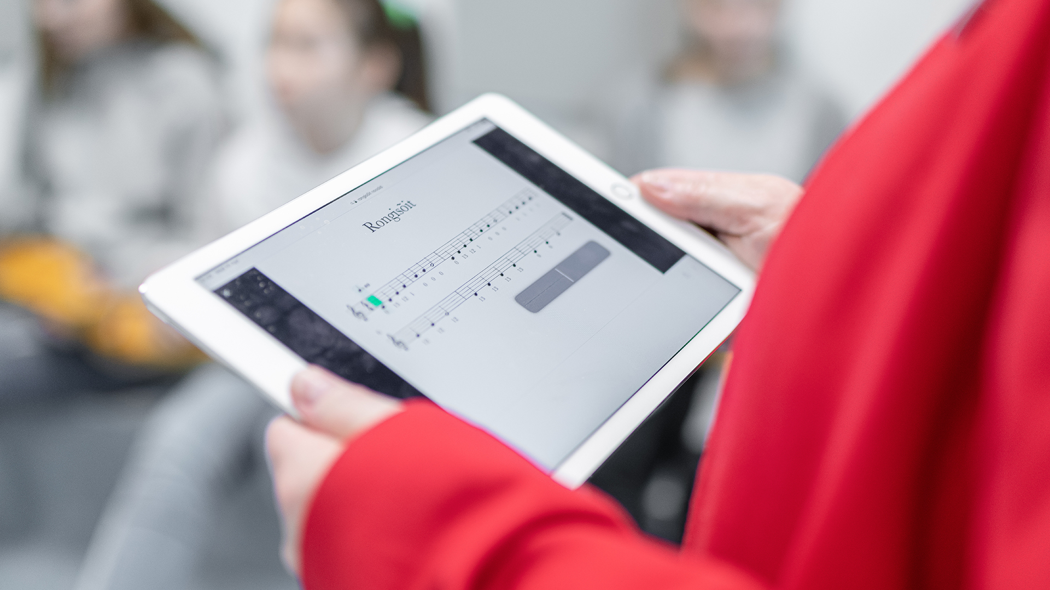
Digital solutions are in everyday use
E-diaries for schools and kindergartens: Eliis, eKool, Stuudium
Digital learning materials and platforms: e-Schoolbag, OPIQ
Student admission systems: DreamApply, SAIS
Examination Infosystem EIS for digital tests
Estonian Education Infosystem EHIS
HarID user administration system
Notes:
15

Slide 16
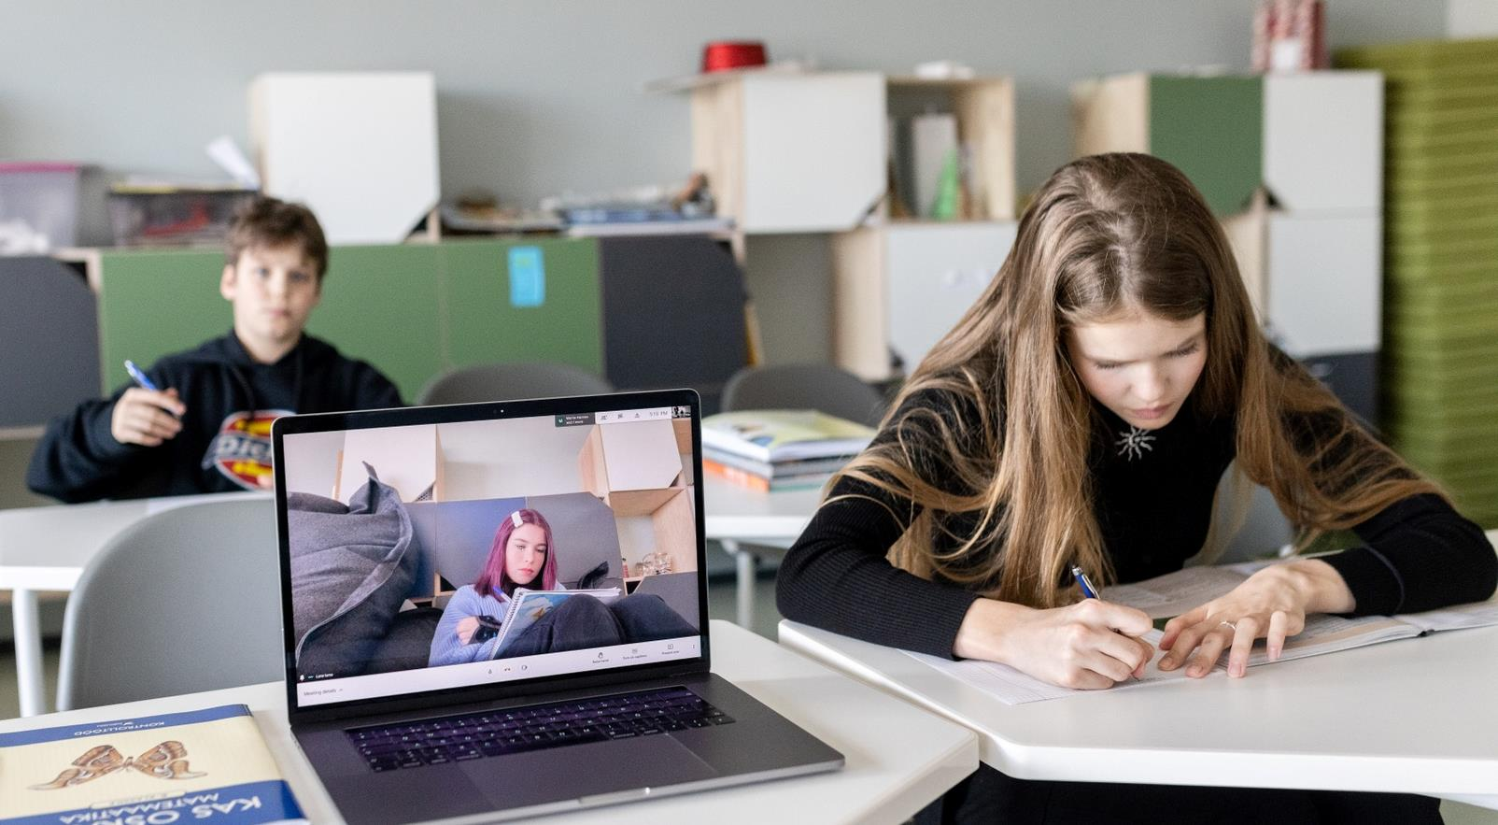
2020: crisis as an opportunity
Technological advantages were a key during the pandemic
Use of e-services increased severalfold
Digital skills of teachers, students and parents improved
Different sectors cooperated effectively

Slide 17
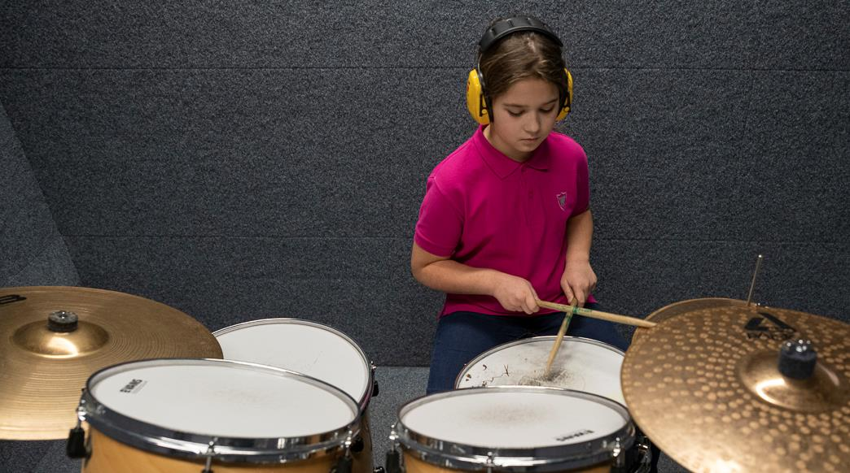
Youth work and hobby education offer more possibilities
Almost half (48%) of the 7-18 year olds participate in hobby education
Notes:
17

Slide 18
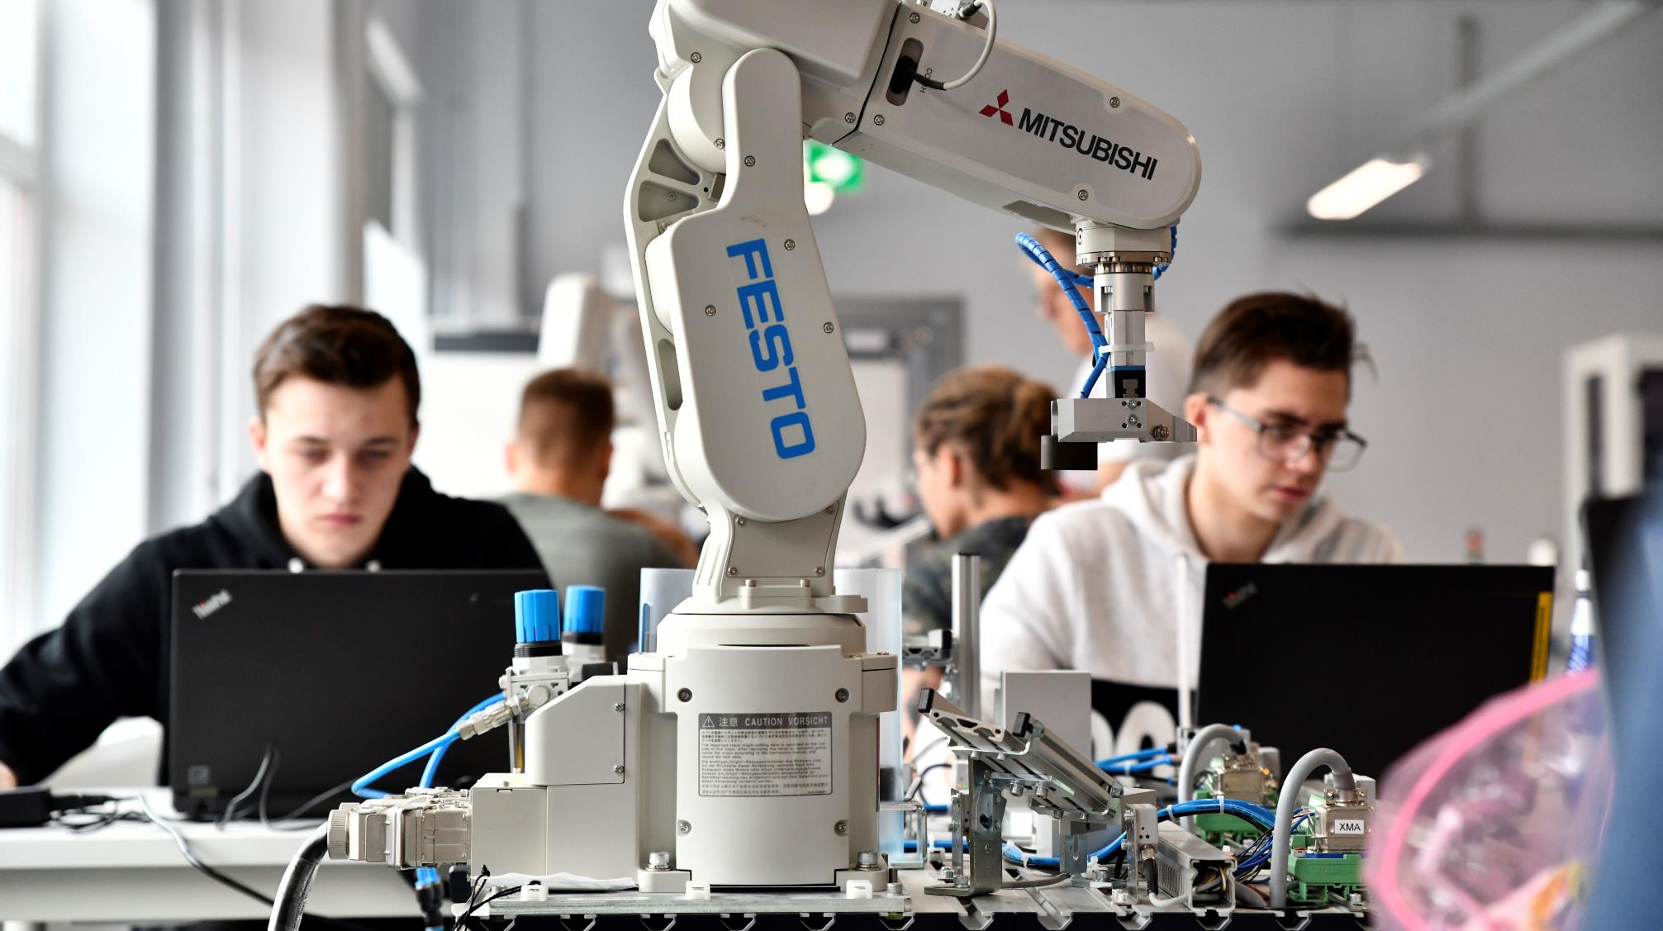
Vocational education: ensuring essential skills
VOCATIONAL EDUCATION is free-of-charge for everybody and has flexible forms of studies.
The state has special project (OSKA) to ANALYSE THE LABOUR MARKET to find out what skills are needed in the future.
Close COOPERATION WITH THE PRIVATE SECTOR provides students real workplace experience during their studies.
Moving from vocational education to higher education and vice versa is becoming increasingly popular.

Slide 19
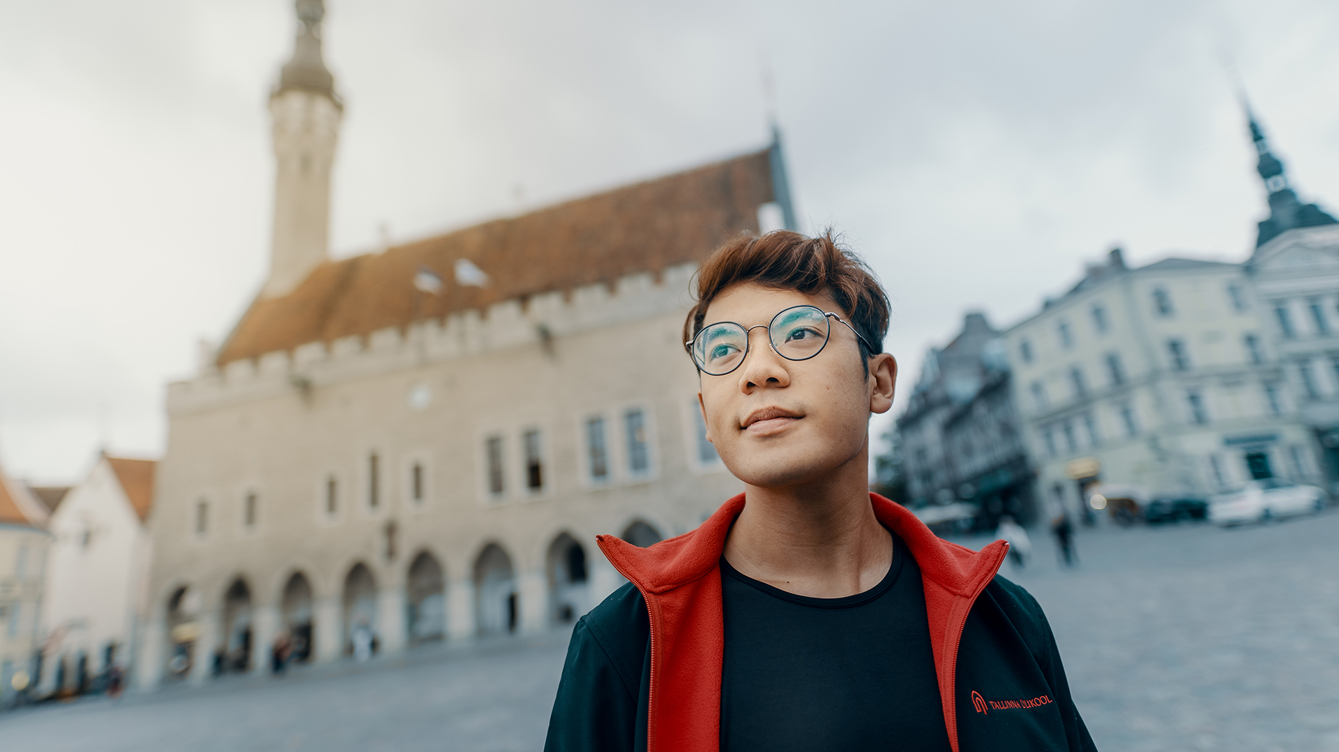
Internationally acknowledged higher education
Estonian universities rank high in prestigious ranking systems such as THE and QS
Innovative study programmes: e-governance, cybersecurity etc
Student projects from self-driving car to space satelliite
Over 150 degree programmes fully taught in English, in 11 internationally accredited universities
Notes:
19
THE – Times Higher Education World University Rankings, www.timeshighereducation.com
QS - QS Quacquarelli Symonds World University Rankings, www.topuniversities.com

Slide 20
Lifelong learning has become a lifestyle in Estonia
Estonians within the 25-64 age group actively participate in learning at almost double the rate of the EU average (17.1% vs 9.2% in 2020).
Notes:
Acquiring new skills, retraining, and completing unfinished schooling are popular: Estonian adults within the 25-64 age group actively participate in learning at almost double the rate of the EU average (17.1% vs 9.2% - Eurostat 2020).

Slide 21
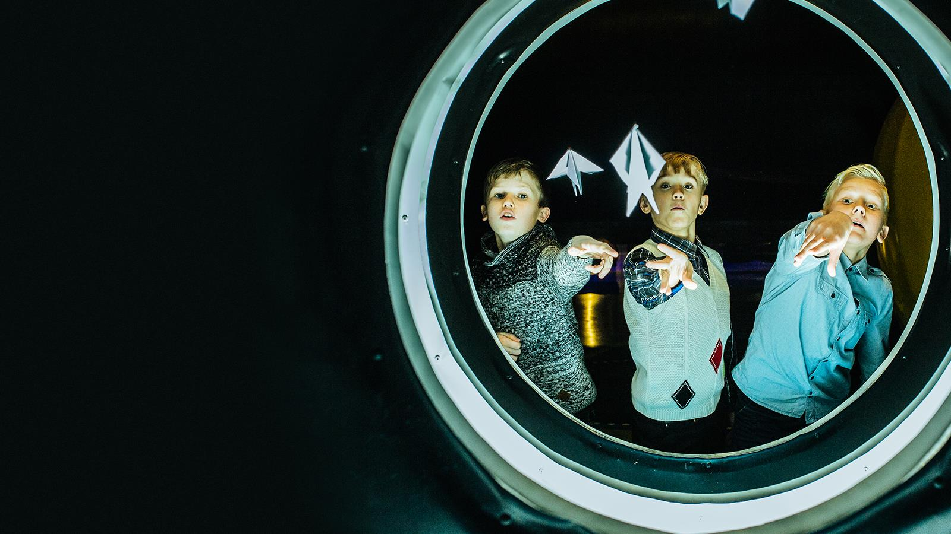
Aitäh!
Photos: Renee Altrov, Aron Urb, Sven Zacek,
Küllike Heide, Lauri Kadajane, Aivo Kallas, Tallinn University, Ajujaht
educationestonia.org
Notes:
21

Slide 22
Read me!
To make your presentation look good, make sure you have the official Estonia Aino font installed. If not, download and install the font separately HERE.

