Slide 1
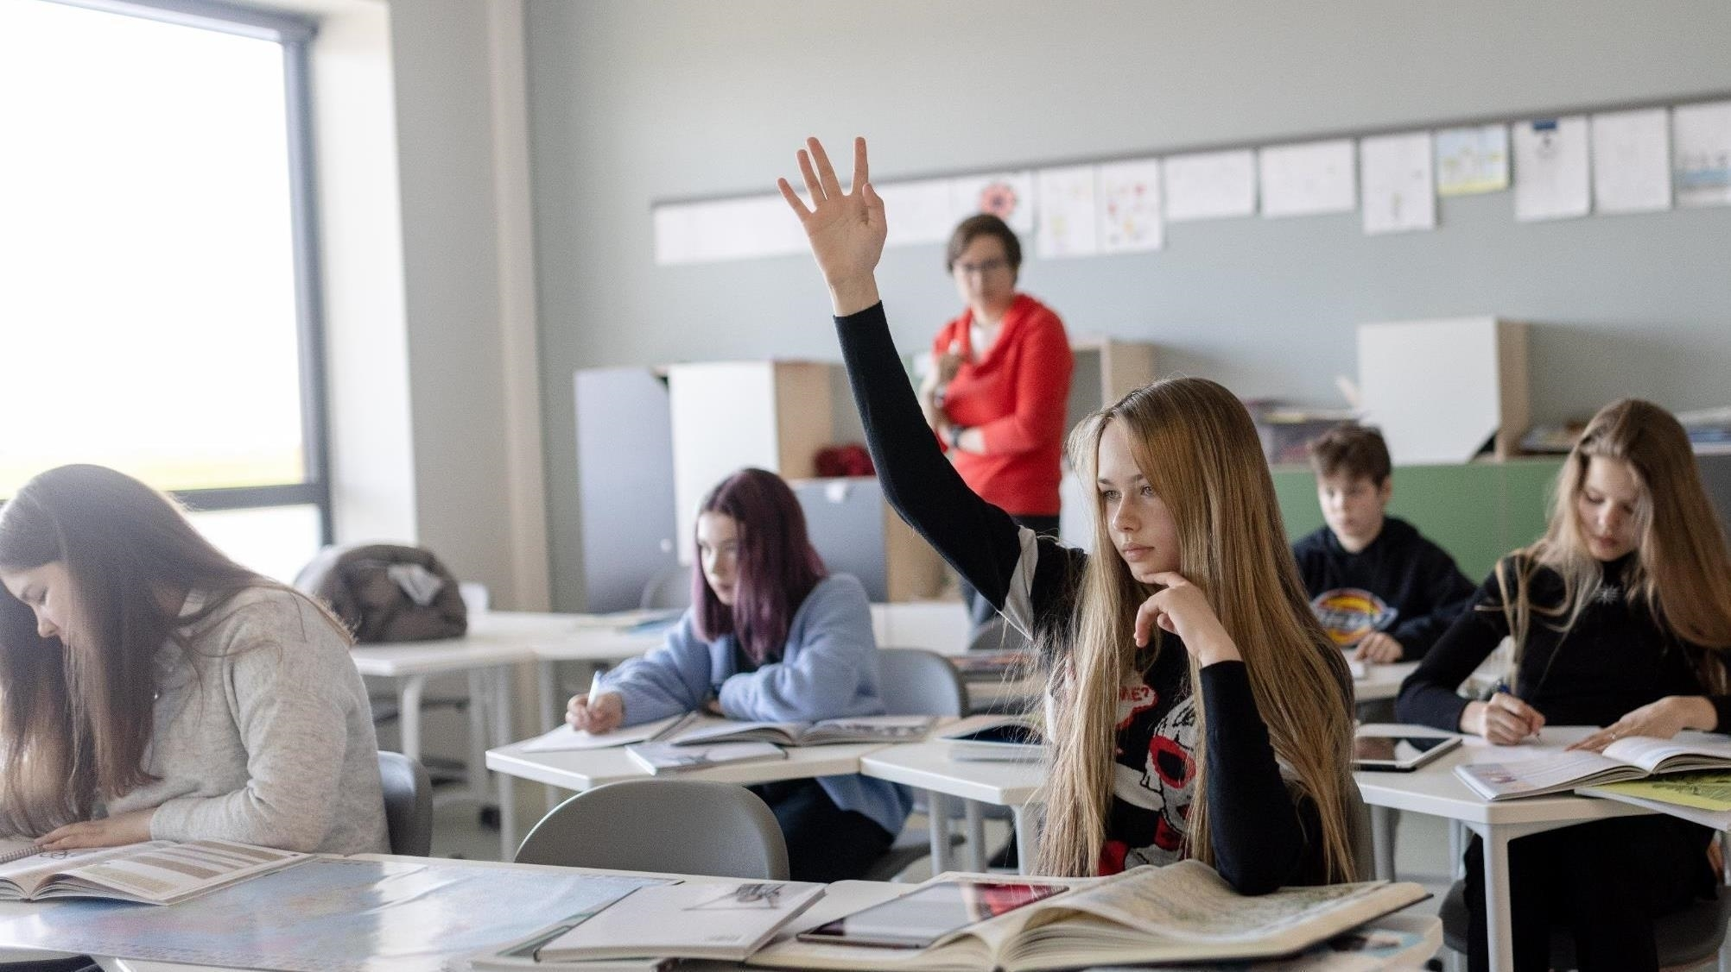
Estonia.
Smart solutions for education innovation

Slide 2

Estonia
population: 1.3 million
45,339 km2
EU, NATO member (since 2004)
99% of public services online

Slide 3



Estonian students rank #1 in Europe (PISA 2018)
4th
5th
8th
in the world in
science
in the world in
reading
in the world in
math
≈ 1.5 times more
top performers
vs OECD average
≈ 2 times less
low performers
vs OECD average
Notes:
PISA 2018 top and low performers. Estonia (vs OECD average)
The share of TOP PERFORMERS:
-Reading 14% (vs 9%)
-Math 16% (vs 11%)
-Science 12% (vs 7%)
The share of LOW PERFORMERS:
-Reading 11% (vs 23%)
-Math 10% (vs 24%)
-Science 9% (vs 22%)
how did we get there?
EDUCATIONAL MINDSET. It has always been both a guarantee of individual success and one of the main drivers of the country's development.
DIGITAL SOCIETY. In a country where 99% of state services are online and people trust e-society, we use the possibilities of technology in education as well.
CAN-DO ATTITUDE. Over the last 30 years, Estonia has implemented a lot of large-scale educational reforms, doing it „the Estonian way“ - quickly and boldly.
INNOVATIVE START-UP CULTURE. State has supported entrepreneurship education for decades. Past years have seen rapid growth in the EdTech sector.

Slide 4
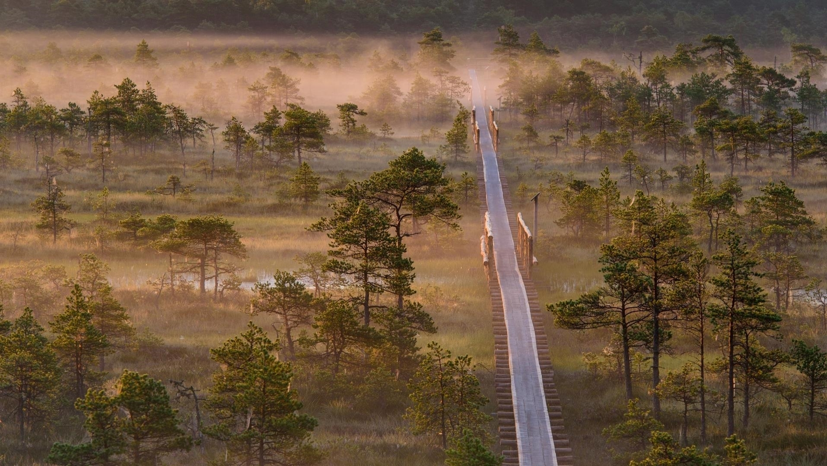
Education has been
highly valued through generations
Before 1918
Under Danish, Swedish, German, Russian rule
13th c. First monastic schools
17th c. Schools for peasant children
1860-70s Compulsory school
1881 Literacy rate 94%
1918-1940
Estonian Republic
1944-1991
Soviet Occupation
Start of the Estonian
national education system.
From 1920 compulsory and
free education for 6 grades.
Estonia managed to maintain
high-quality teaching and learning
in Estonian.
1991
Republic of Estonia
The modernisation of Estonian education begins.
Notes:
EDUCATIONAL MINDSET. It has always been both a guarantee of individual success and one of the main drivers of the country's development.
Literacy rate - ability to read was one of the highest rates in the world at that time and triple compared to the average in Russian empire. "Compared with the huge Russian empire, to which Estonia belonged at the time, the level of literacy here was immeasurably higher: according to the 1881 census, 94 per cent of the population could read and 48 per cent could read and write." Estonica.org
Work hard and aim high mindset is still prevalent among Estonian students. Estonian students exhibit the largest growth mindset - 77% (OECD average 63%), (PISA 2018). Majority of students diagreed that “Your intelligence is something about you that you can’t change very much“. www.oecd.org/pisa/growth-mindset.pdf

Slide 5
Restart of the education system
VOCATIONAL EDUCATION REFORMS start build
a flexible and practical
system relevant to the needs
of the labor market
EXTERNAL QUALITY ASSURANCE
of education
LANGUAGE IMMERSION
PROGRAMME
to foster bilingualism
1992
1996
1999
2001
1994
1997
2000
NATIONAL CURRICULUM
for general education with the focus
on learning outcome, decentralisation, and school autonomy
All SCHOOLS CONNECTED TO THE INTERNET and provided with computers
THE LAW ON EDUCATION of the Estonian Republic
sets general principles
1999-2009
Harmonising HIGHER EDUCATION
with European standards:
recognition of diplomas
3 main study cycles
scholarships for mobility
accreditation system
internationalisation
ENTREPRENEURSHIP becomes
a key topic in Estonian education:
1992 student companies
2011 entrepreneurship as a
key competence in curricula
2016 Edu ja Tegu programme
TIGER LEAP programme provided schools with computers, internet access, and teacher training. The programme also laid the foundation for a successful
PUBLIC-PRIVATE PARTNERSHIP
in Estonian education.
Notes:
The slides provide an overview of a selection of important educational reforms and initiatives since the 1990s
Additional info:
The TIGER LEAP PROGRAMME started the digitalisation of the entire public sector in Estonia. In few years, Estonia became the first country in Europe to provide stable internet connection to all schools. www.educationestonia.org/tiger-leap/
The NATIONAL CURRICULUM for general education has been updated regularly afterwards (2002, 2011, 2014)

Slide 6
E-SCHOOL -
web application for schools provides
an easy way for parents, teachers, and pupils to share information
Requirement to DIGITIZE ALL LEARNING MATERIALS
by 2020
2015-2022
MODERNISING INTERNET CONNECTION in all schools
Future skills forecasting programme OSKA is launched to better connect the education system with the expectations of the labour market
FREE LUNCH in basic school,
starting from 2014 also
in upper secondary school
Optimising school network:
building of regional STATE GYMNASIUMS begins
2004
2005
2010
2014
2002
2006
2011
2015
INCLUSIVE EDUCATION
as a leading principle
LIFELONG LEARNING STRATEGY 2020:
with a DIGITAL FOCUS and a lot of emphasis on
IN-SERVICE TRAINING on teachers and
school leaders professional development
Establishment of Rajaleidja
SUPPORT CENTRES NETWORK
with offices in every county
PROFESSIONAL STANDARDS FOR TEACHERS create the conditions for systemic teacher education responsive to the needs of society
More variability to educational landscape: changes in school funding principles make
the establishment of
PRIVATE SCHOOLS easier
A state database EHIS brings together all information related to education in Estonia

Slide 7
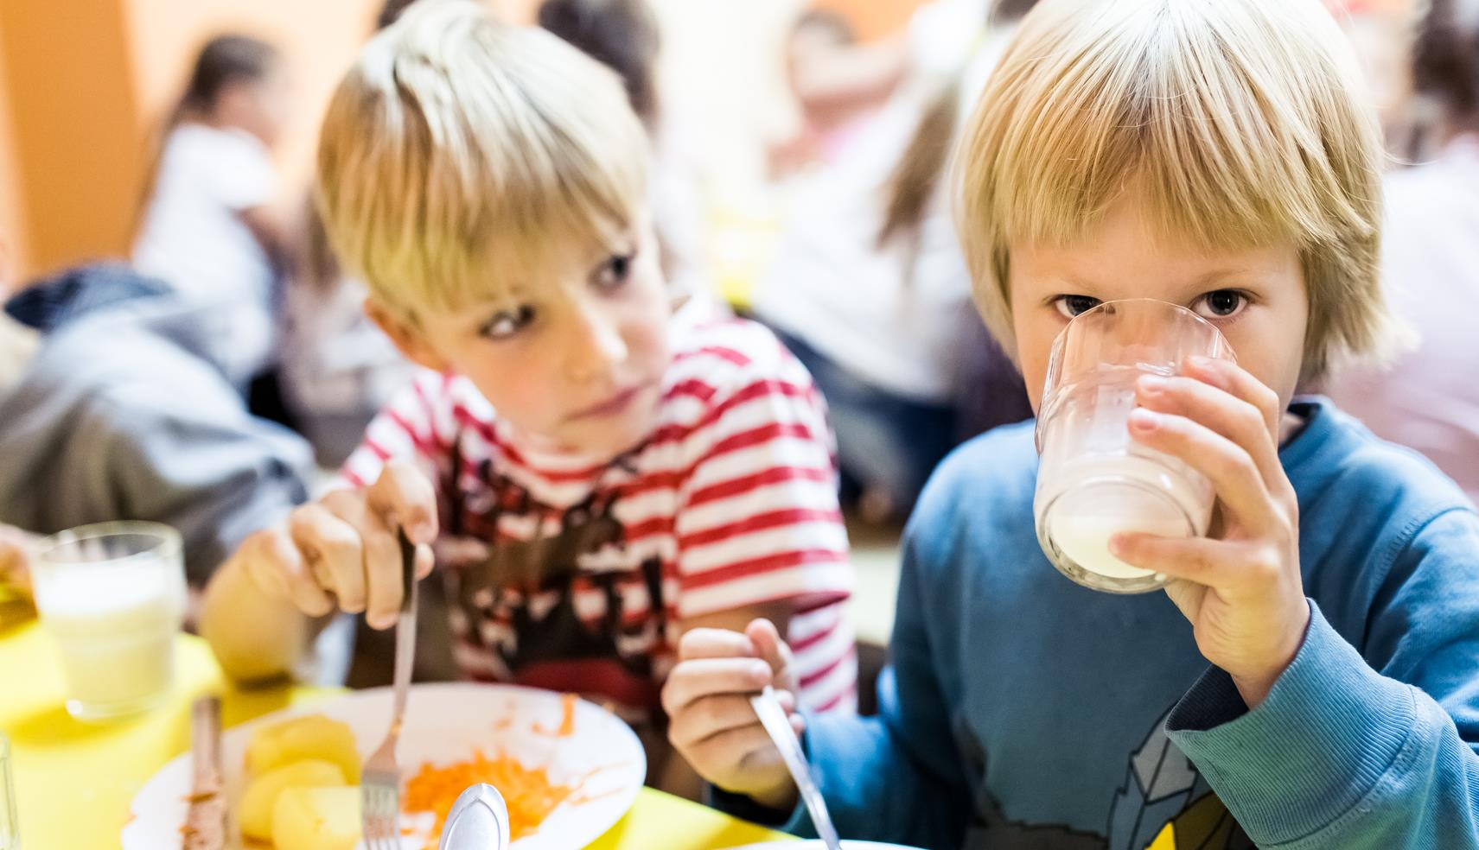
Everyone has the right for a high quality education
In Estonia, student’s socio-economic background
has a low impact on performance
(6.2 % of variation compared to 12% in OECD)
Notes:
No one is left behind: Equal Opportunities for All
Estonia believes in equal opportunities for all. Education is free from basic to higher education, and students receive free school meals and textbooks. Every child has the right to a good education, regardless of their socio-economic background.
Estonia has implemented an inclusive education system where students with different abilities study together. All children, including those with special needs, are entitled to receive equal education and support. The country offers free special support by psychologists and speech therapists at school or counseling centers found in every county.

Slide 8
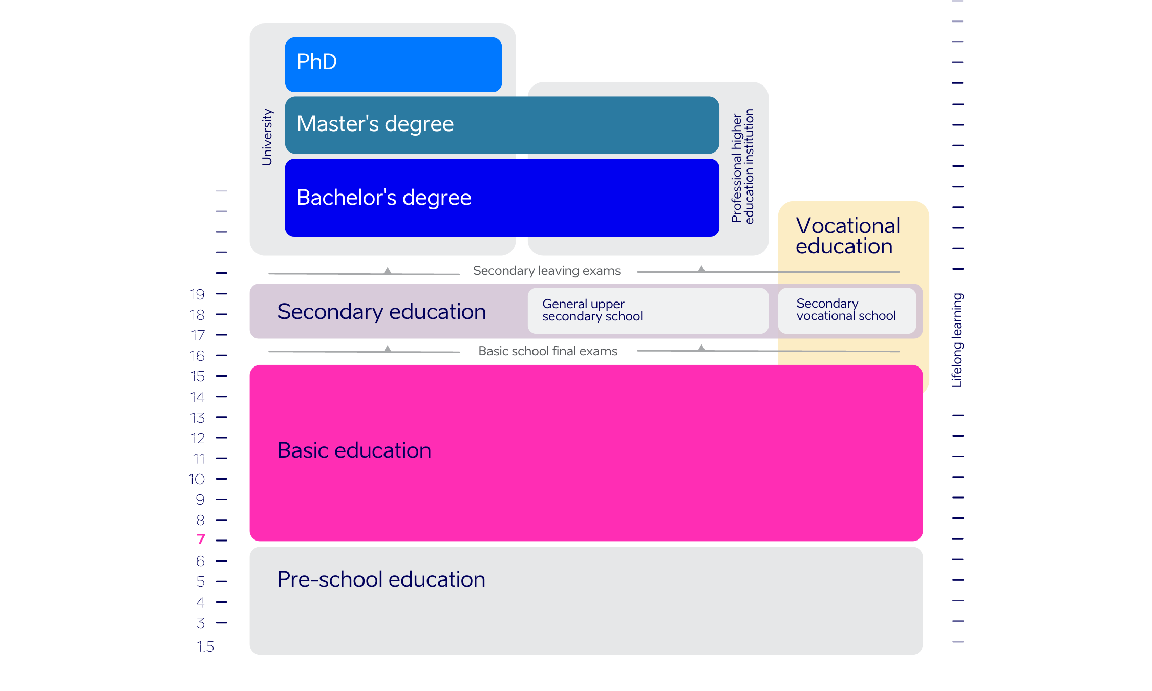
Estonian education today
General education:
156,786 students
16,569 teachers
517 schools
Notes:
Basic education is minimum compulsory general education. Compulsory education starts at the age of seven and lasts from grades 1 to 9.
In general education, schools are mostly run by local governments. There are ≈ 11% of private schools in Estonia. In both cases, the number of students is used to calculate the amount of state subsidies allocated for covering expenses on teachers’ salaries, training and textbooks.
Pre-school education: 66,979 students, 8012 teachers, 597 pre-school institutions
Vocational education: 25,862 students, 2,086 teachers, 37 schools
Higher education: 44,611 students, 18 educational institutions offering higher education in Estonia
Data: haridussilm.ee 2021/22

Slide 9
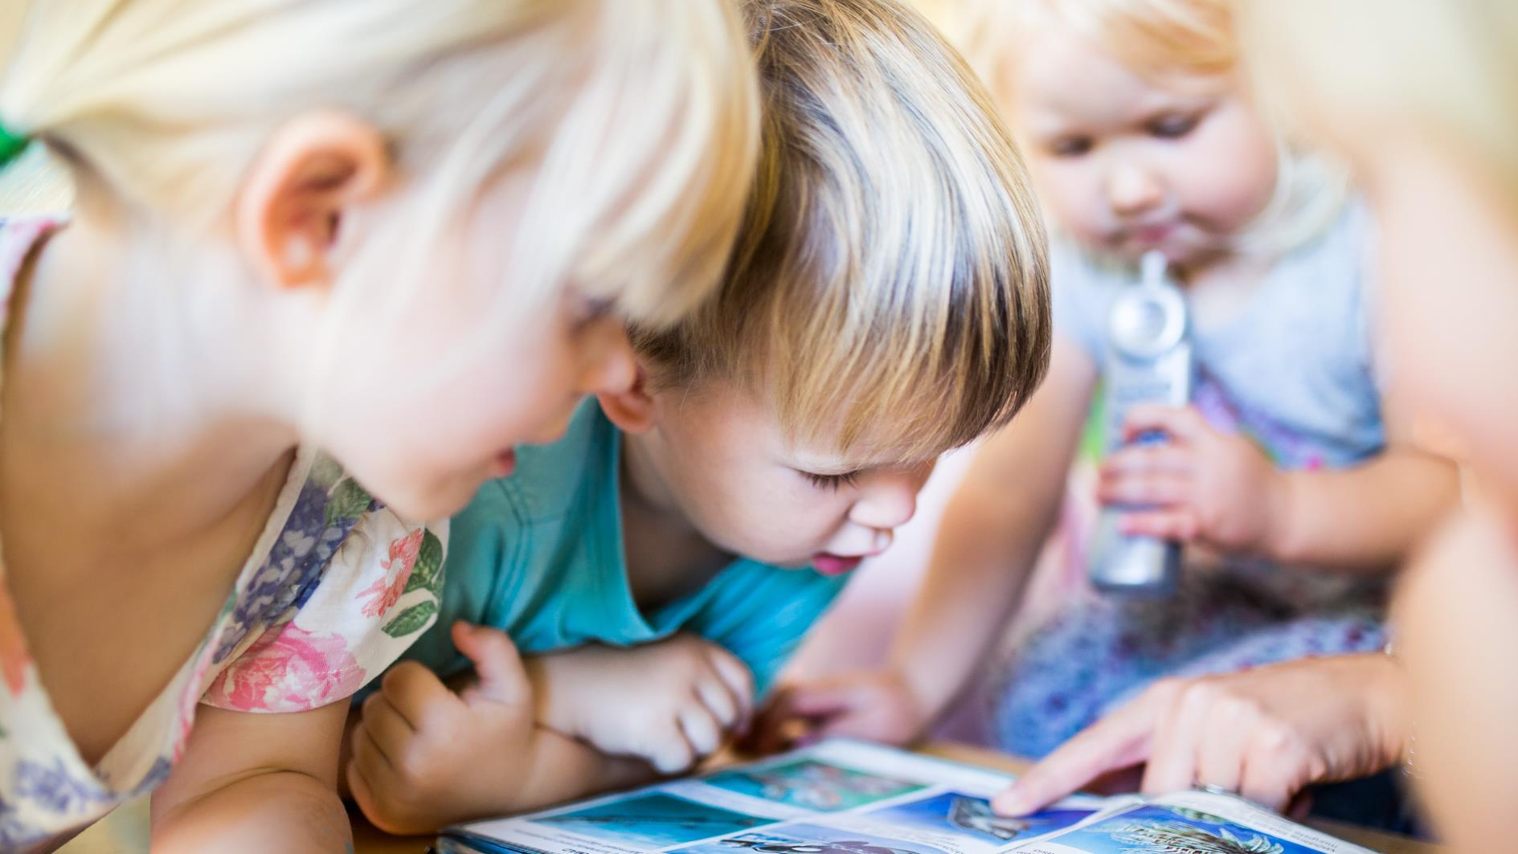
Preschool: preparing for school
94% of 4-6-year children attend kindergarten,
though this is not compulsory in Estonia
Curriculum-based learning outcomes
are achieved by learning-through-play method
Notes:
9
Estonia recognizes the critical role that high-quality early childhood education plays in a child's development. Kindergartens in Estonia are not just for childcare, they are educational institutions with their own curriculum designed to prepare children for school. Although preschool attendance is not mandatory, over 90% of children participate, demonstrating parents' desire for their children to be well-prepared for their academic journey.

Slide 10
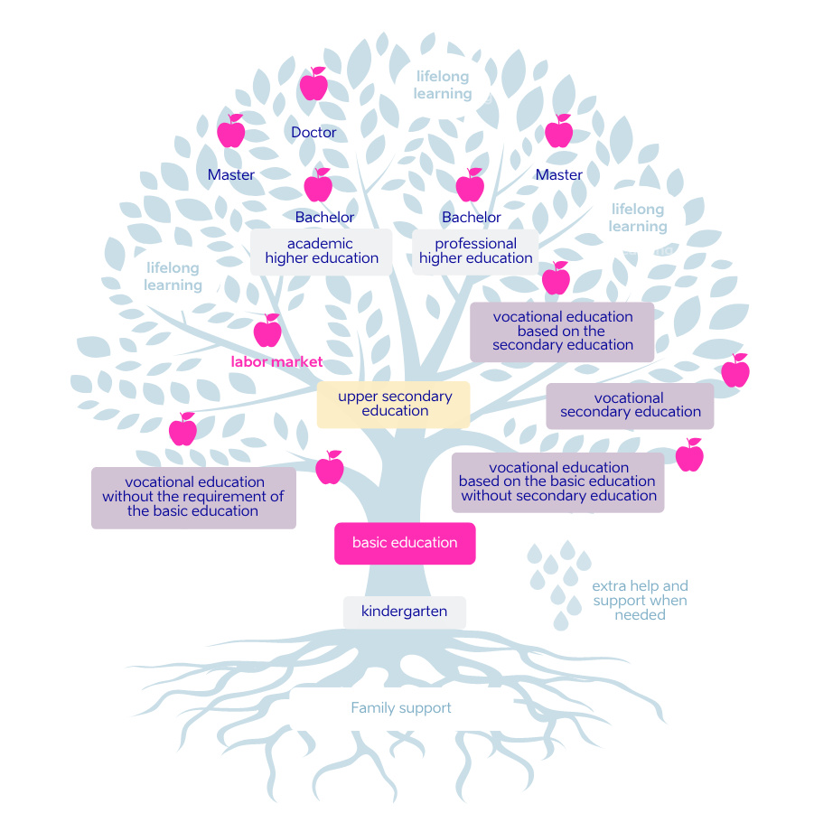
The strength of the tree depends on its roots
No matter which path you have started on, you have the possibility to move on
from one branch to another.

Slide 11
Characteristics of Estonian education
TEACHERS ARE HIGHLY EDUCATED.
A teaching qualification requires the completion of a Master's degree.
Schools, principals and teachers
have A LOT OF AUTONOMY.
Estonia has successfully implemented an INCLUSIVE EDUCATION SYSTEM. Students with different abilities study together.
All students are entitled for free SPECIAL SUPPORT by psychologists, speech therapists at school or at the counselling centres found in every county.
EXTERNAL EVALUATION of learning outcomes gives valuable feedback.
EDUCATION IS FREE-OF-CHARGE
from basic to the higher education.
School meals, textbooks, and transit
are free for all students.
HOBBY EDUCATION offers wide opportunities for self-development
in music, sports, art, technology, etc.
STRATEGIC PLANNING, involving important stakeholders, is a crucial element of Estonia's education system.
Notes:
HIGHLY EDUCATED TEACHERS. Estonian teachers are highly educated, requiring a master's degree to work as a teacher and a bachelor's degree for a kindergarten teacher. Estonia has a culture of trusting and empowering teachers. The curriculum only sets the results that children should know by the end of school, while teachers decide how to achieve those results. Parents and the state trust teachers to make the best decisions for their students.
AUTONOMY: Every school creates their own curricula on the basis on national curriculum. principals can decide on teachers salaries and how the money is spent etc, teachers are free to decide how they reach learning outcomes set in curricula

Slide 12
Preparing for the information society
95%
4th
1st
of schools
use e-diaries
in media literacy
Media Literacy Index 2022
in digital learning
CEPS 2019
99%
9%
40%
of Estonian kindergartens
take part in technology education programme ProgeTiger
of students study ICT in Estonia
– twice as many as EU average
Eurostat 2018
of ICT university students are female – this is highest share in Europe Informatics Europe 2020
Notes:
99% of kindergartens and 98% of schools took part in ProgeTiger programme, Education and Youth Board 2020
8.86% of all students studied ICT (BA+MA) in Estonia, while EU average is 4.65%, Eurostat 2018
2019/2020 40% of ICT Master students were female in Estonia, www.informatics-europe.org
1st in digital learning - CEPS (Centre for European Policy Studies) assessed European countries’ performance in digital learning and found that Estonia, the Netherlands and Finland excel in the digitalisation of education. www.educationestonia.org/estonia-no-1-in-europe-for-digital-learning/

Slide 13
Technology opens up new possibilities
The Tiger Leap programme
in the 1990s provided schools with INTERNET CONNECTIONS, COMPUTERS, and IT TRAININGS.
For the evidence-based decisions,
the EDUCATIONAL DATA is publicly
accessible on the internet.
DIGITAL LEARNING MATERIALS
are available for all subjects and
across all educational levels.
DIGITAL COMPETENCE is set
in curriculum as a general competence.
Educational programmes create INTEREST IN TECHNOLOGY from kindergarten to university.
All schools in Estonia use E-SOLUTIONS.
Many schools and kindergartens have EDUCATIONAL TECHNOLOGISTS
- technology integration specialists
to support teachers.
Notes:
In a country where 99% of state services are online, technology is also used extensively in education.
TIGER LEAP INTO THE FUTURE. Estonia's efforts to leverage technology for teaching and learning began in the 1990s with an ambitious Tiger Leap programme that kickstarted the digitalization of the entire public sector. The aim of the programme was to provide internet access to all schools. By 2001, Estonia had already met this goal. However, Tiger Leap also prioritized the training of teachers, students, and citizens to become tech-savvy, recognizing that digital opportunities are only as good as the people who use them.
DATA-BACKED DECISIONS. Pragmatic Estonians value evidence-based decision-making. Since 2004, Estonia has been using the Estonian Education Information System to gather information on its education system. The database provides policymakers, educators, and researchers with a wealth of information on student performance, teacher qualifications, and more.
DIGITAL LEARNING MATERIALS. In Estonia, all learning materials must have a digital version as well. This made the transition to distance learning in Estonian schools much smoother in 2020, as digital learning materials were already available for all education levels and subjects. It seems as if Estonia had been preparing for this for 25 years.
DIGITAL LITERACY AND TEACHER TRAINING. With a focus on digital literacy, digital competence is one of the core skills that students develop across all subjects, as outlined in the national curriculum in Estonia. Teachers are also encouraged to develop their own digital skills through ongoing training, with one in five Estonian teachers participating in digital competence courses every year.
E-TESTS. Estonian schools also use e-tests to save teachers' time and make testing and feedback more efficient. In the coming years, Estonia plans to make final exams electronic as well, further streamlining the testing process.
INFRASTRUCTURE. Digital opportunities are only as good as the infrastructure supporting them. Recognizing this, the Estonian government has invested in the infrastructure of schools to ensure that they have access to high-speed internet connections. This has allowed for a more seamless integration of digital tools and materials in the classroom, improving the learning experience for students and teachers alike.

Slide 14
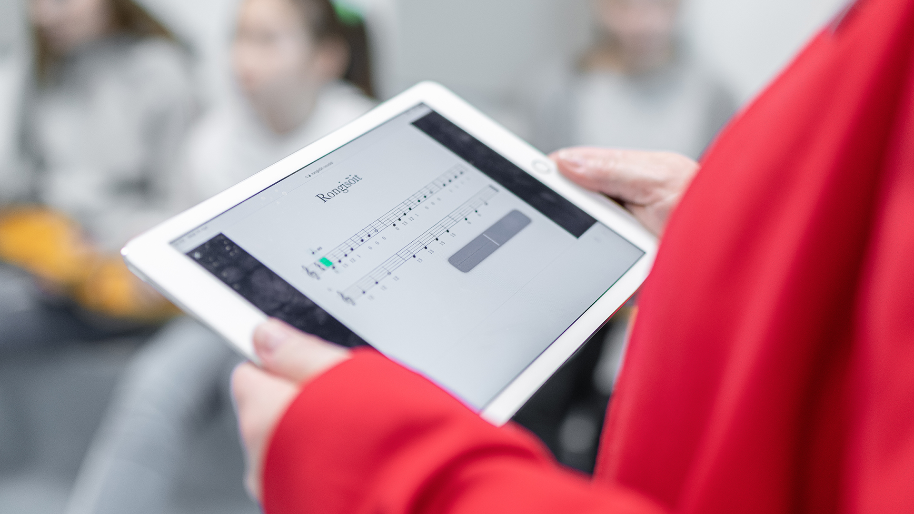
Digital solutions are in everyday use
E-diaries for schools and kindergartens: Eliis, eKool, Stuudium
Digital learning materials and platforms: e-Schoolbag, OPIQ
Student admission systems: DreamApply, SAIS
Examination Infosystem EIS for digital tests
Estonian Education Infosystem EHIS
HarID user administration system
etc
Notes:
14
Since the introduction of the E-DIARY PLATFORM EKOOL IN 2002, digital tools have been seamlessly integrated into education. The government has invested in the infrastructure of schools to provide access to high-speed internet, allowing more seamless integration of digital tools and materials in the classroom.

Slide 15
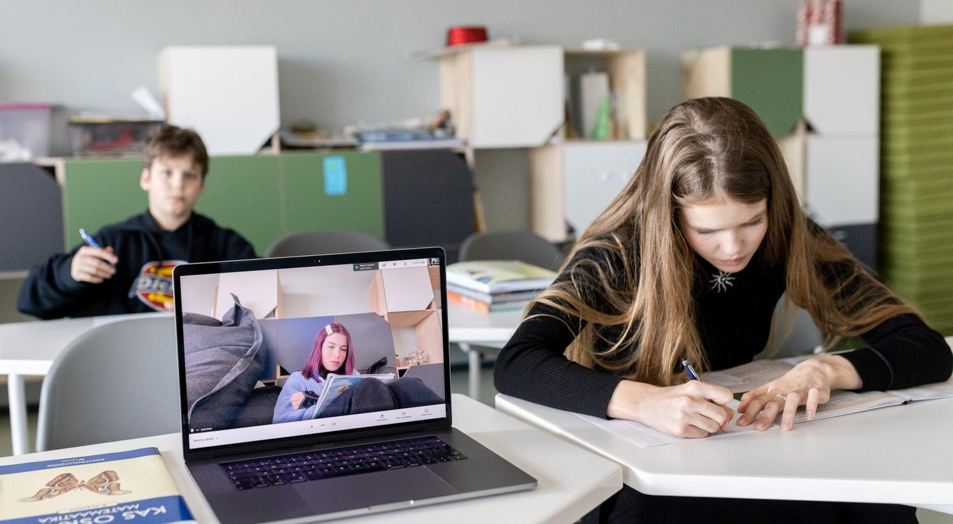
2020: crisis as an opportunity
Technological advantages were a key during the pandemic
Use of e-services increased severalfold
Digital skills of teachers, students and parents improved
Different sectors cooperated effectively

Slide 16
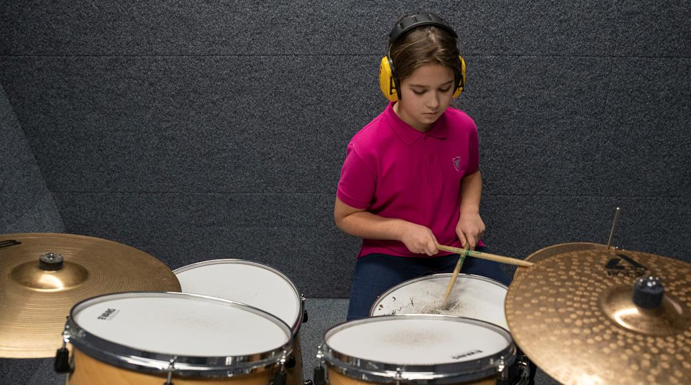
Youth work and hobby education offer more possibilities
Almost half (48%) of the 7-18 year olds
participate in hobby education
90% of youth are satisfied with youth work
and extracurricular activities (2020)
Notes:
16

Slide 17
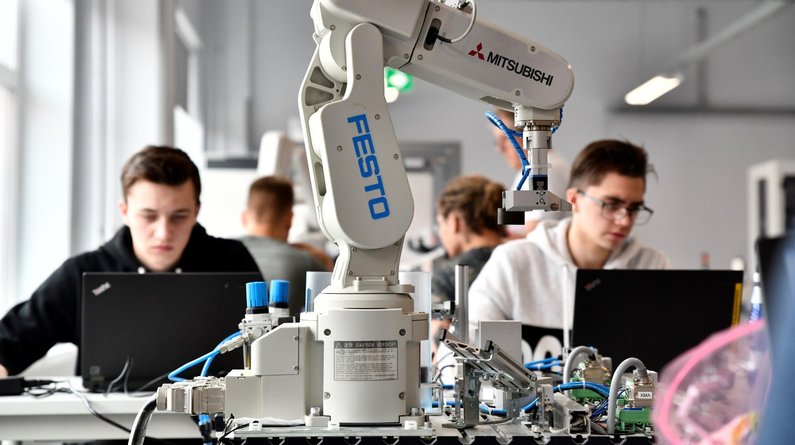
Vocational education: ensuring essential skills
VOCATIONAL EDUCATION
is free-of-charge for everybody
and has flexible forms of studies.
The state has special project (OSKA) to ANALYSE THE LABOUR MARKET to find out what skills are needed in the future.
Close COOPERATION WITH THE PRIVATE SECTOR provides students real workplace experience during their studies.
Moving from vocational education
to higher education and vice versa
is becoming increasingly popular.

Slide 18
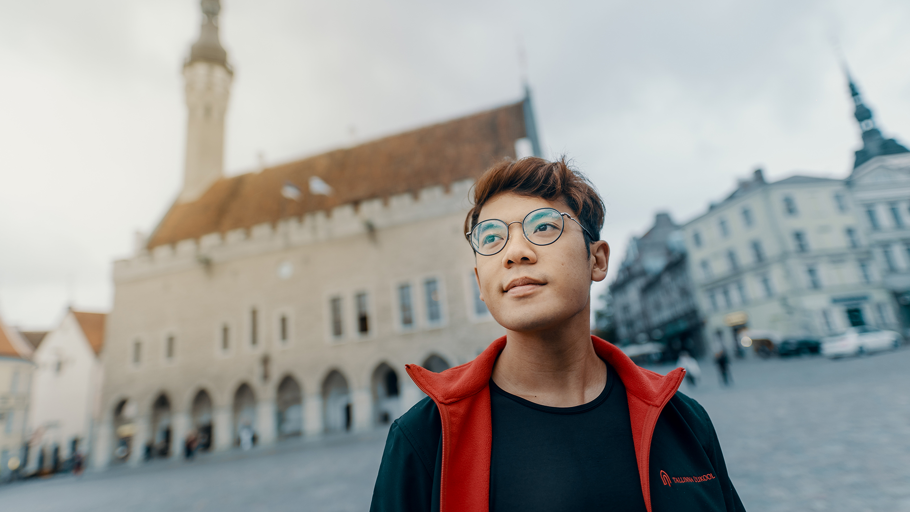
Internationally acknowledged higher education
Estonian universities rank high in prestigious
ranking systems such as THE and QS
Innovative study programmes: e-governance, cybersecurity etc
Student projects from self-driving car to space satelliite
Over 150 degree programmes fully taught in English,
in 11 internationally accredited universities
Notes:
18
THE – Times Higher Education World University Rankings, www.timeshighereducation.com
QS - QS Quacquarelli Symonds World University Rankings, www.topuniversities.com

Slide 19

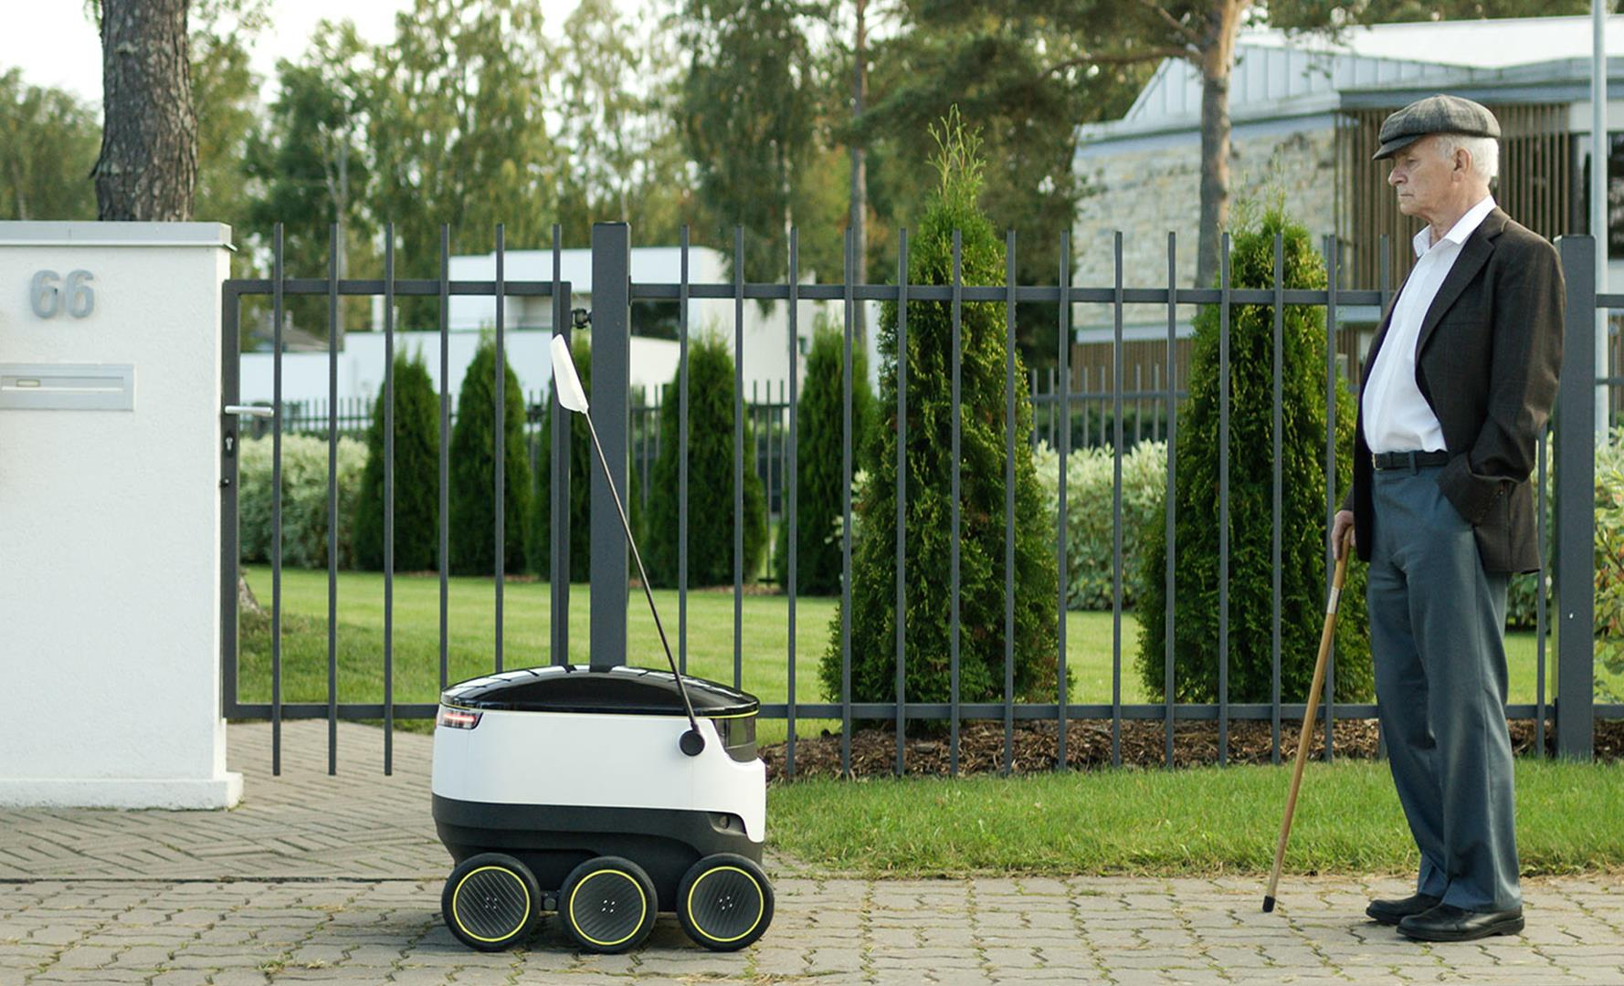
Lifelong learning has become a lifestyle in Estonia
Estonians within the
25-64 age group actively participate in learning
at almost double the rate
of the EU average
(17.1% vs 9.2% in 2020).
Notes:
Acquiring new skills, retraining, and completing unfinished schooling are popular: Estonian adults within the 25-64 age group actively participate in learning at almost double the rate of the EU average (17.1% vs 9.2% - Eurostat 2020).

Slide 20
We truly think that the best thing we can give to our children is not land, house or a bank account, but good education.
T. H. Ilves
T. H. Ilves, the former president of Estonia
Notes:
20

Slide 21
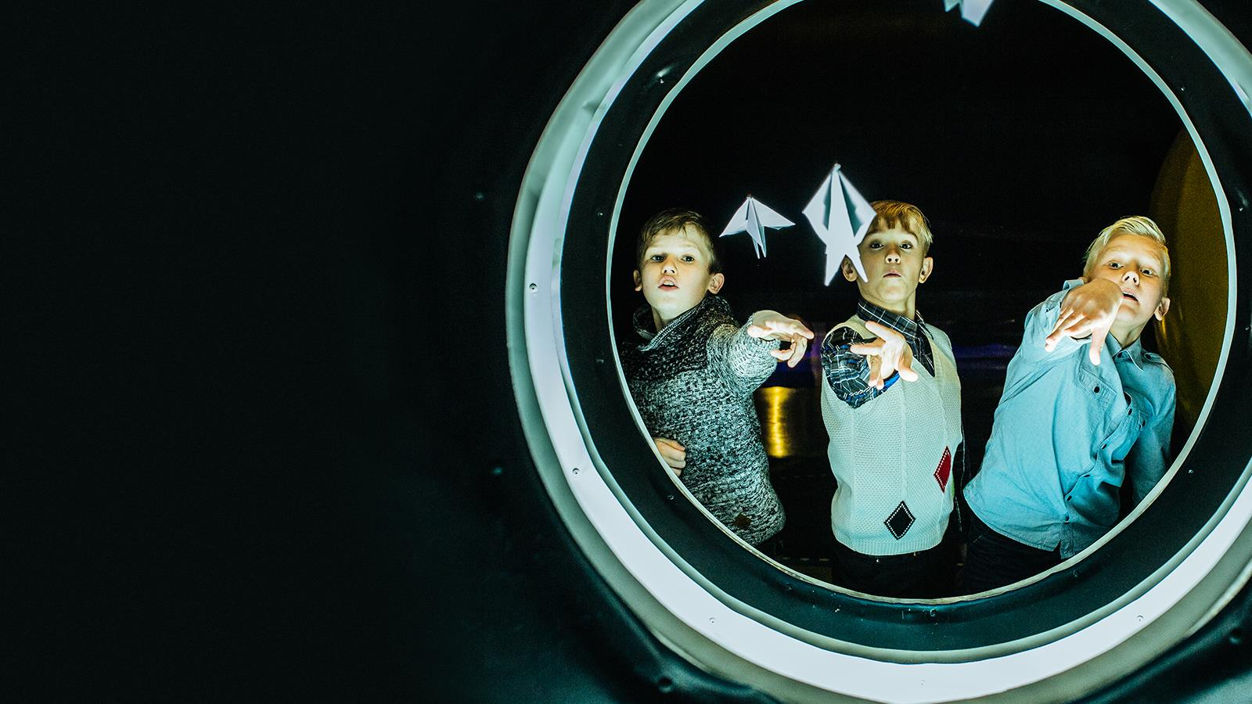

Aitäh!
Photos: Renee Altrov, Aron Urb, Sven Zacek,
Küllike Heide, Lauri Kadajane, Aivo Kallas, Tallinn University, Ajujaht
educationestonia.org
Notes:
21

Slide 22

Read me!
To make your presentation look good, make sure you have
the official Estonia Aino font installed.
If not, download and install the font separately HERE.

