Slide 1
Estonia. Smart solutions for education innovation
Author
date
© Renee Altrov

Slide 2
Education has been highly valued through generations
© Tõnu Runnel

Slide 3
Facts and figures
PISA results of Estonian students rank first in Europe
4th
5th
8th
in the world in science skills (PISA 2018)
in the world in reading skills (PISA 2018)
in the world in math skills (PISA 2018)
95%
1st
of schools
use e-diaries
in digital learning (CEPS 2019)

Slide 4
How did we get there?
EDUCATIONAL MINDSET It has always been both a guarantee of individual success and one of the main drivers of the country's development.
CAN-DO ATTITUDE Over the last 30 years Estonia has had to rebuild the entire country after the restoration of independence. Estonia has implemented a lot of large-scale educational reforms, doing it „in Estonian way“ - fast and boldly.
DIGITAL SOCIETY In a country where 99% of state services are online and people trust e-society, we use the possibilities of technology also in education. That helped us also to handle distance learning during the pandemic.
INNOVATIVE START-UP CULTURE Past years have seen a rapid growth in the EdTech sector. Good public private cooperation has helpled to tackle challenges, solve crises and create new solutions

Slide 5
Characteristics of Estonian education
Estonia has sucessfully implemented INCLUSIVE EDUCATION SYSTEM. All students learn side by side in the same classroom and are entitled for free special support if needed.
Schools, school leaders, and teachers have A LOT OF AUTONOMY in Estonia. All teachers are required a Master’s degree.
As a digital nation, technology has a big role in education. ALL SCHOOLS USE E-SOLUTIONS such as digital learning materials or e-school for communication between home and school.
Children start school at the age of seven. STUDY AND HOLIDAYS ARE IN BALANCE: Thanks to efficient use of time, our school day and school year are shorter than in many other countries.

Slide 6
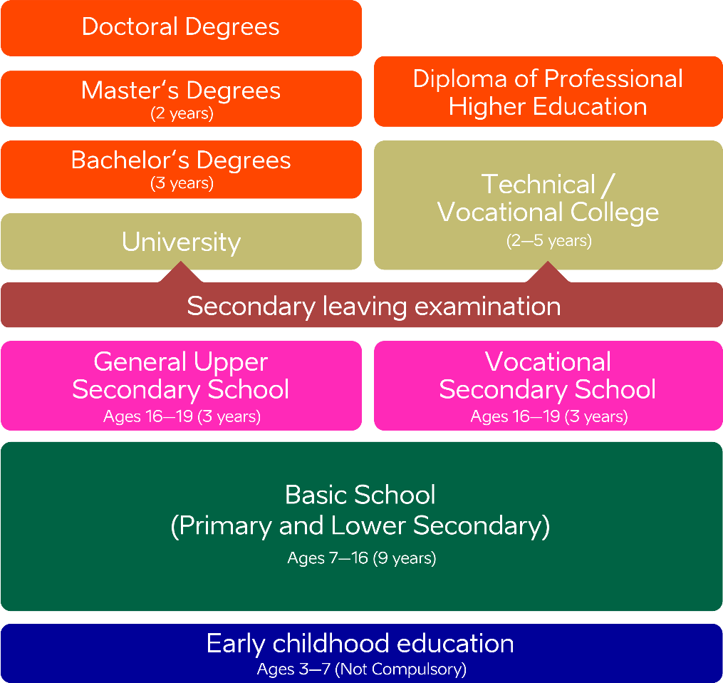
Estonian education system

Slide 7
Everyone has a right for high level education
© Lauri Kadajane
Students with different abilities study together
Free textbooks and school lunch
Free support services if needed
Students’ socio-economic status has the lowest impact on performance in the OECD

Slide 8
Pre-school: preparing for school
© Lauri Kadajane
Curriculum based learning outcomes are achieved by learning-through-play method
94% of children attend kindergarten, though this is not compulsory in Estonia
68% of Estonian pre-school teachers have Bachelor’s or Master’s degree

Slide 9
Technology has a big role in education
The Tiger Leap programme in 90s aimed to establish an up-to-date IT infrastructure in the country, with a special focus on schools, providing internet connection, computers and IT trainings.
The educational project started the digitalisation of the entire public sector in Estonia. In few years, Estonia became the first country in Europe to provide stable internet connection to all schools.
Today, digital learning materials are available for all subjects and across educational levels and Estonian schools use wide range of e-school solutions.
Different educational programmes create interest in technology from kindergarten to vocational and higher education.
For the evidence-based decisions the educational data is accessible on the Internet.

Slide 10
Facts and figures
99%
8.8%
40%
of Estonian kindergartens
take part in technology education programme ProgeTiger
of students study ICT in Estonia – twice as many as EU average
(Eurostat)
of ICT University students are female – this is highest share in Europe (Eurostat)

Slide 11
Digital solutions in everyday use
© Aivo Kallas
E-diaries for schools and kindergartens: Eliis, eKool, Stuudium
Digital learning materials and platforms: e-Schoolbag, OPIQ, Foxcademy
Student admission systems: DreamApply, SAIS
Examination Infosystem etc

Slide 12
2020: crisis as an opportunity
© Lauri Kadajane
Technological advantages were a key during the global pandemic
Different sectors cooperated effectively
Use of e-services increased severalfold
Digital skills improved a lot

Slide 13
Internationally acknowledged higher education
© Tallinna Ülikool / Tallinn University
Estonian universities rank high in prestigious ranking systems such as THE and QS
Innovative study programmes: e-governance, cybersecurity
Student projects from self-driving car to space satelliite
Over 150 degree programmes fully taught in English, in 11 internationally accredited universities

Slide 14
Ensuring essential skills
VOCATIONAL EDUCATION is free-of-charge for everybody and has flexible forms of studies. Close cooperation with the private sector provides students real workplace experience during studies. Moving from vocational education to higher education and vice versa is becoming increasingly popular.
The state has special project (OSKA) to ANALYSE THE LABOUR MARKET to find out what skills are needed in the future.
YOUTH WORK AND INFORMAL EDUCATION provide additional opportunities to develop skills needed. Estonian youth work is among the best according to OECD.
LIFELONG LEARNING. Acquiring new skills, retraining, and completing unnished schooling are popular in Estonia: every fifth of all 25-64-year-olds attended at least one training last year.

Slide 15
Lifelong learning has become a lifestyle In Estonia
© Ken Oja

Slide 16
Your guide to smart solutions
Are you interested in
particular digital solution,
study visit, etc.?
EDUCATIONESTONIA.ORG
Interested in
research opportunities
in Estonia?
RESEARCHINESTONIA.EU
Would you like to know more about study opportunities?
STUDYINESTONIA.EE

Slide 17
Aitäh!
© Aron Urb

