Slide 1
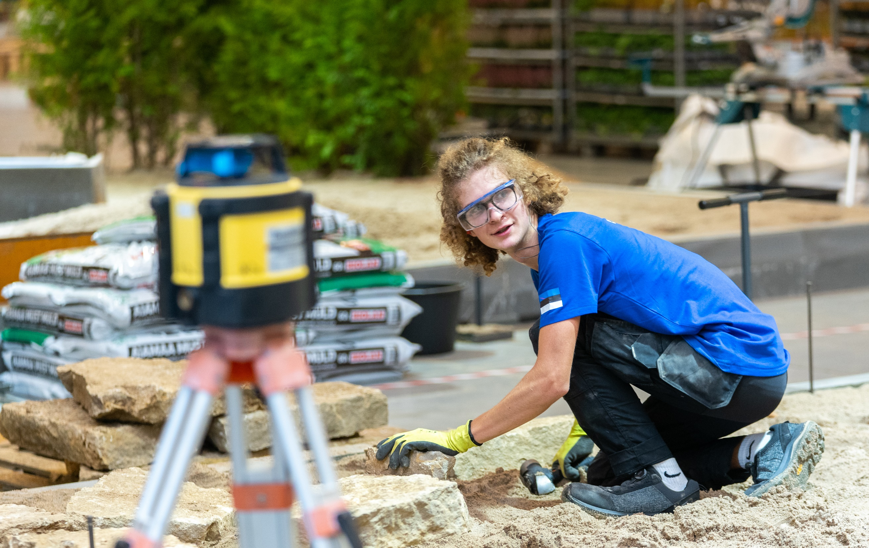
Vocational Education in Estonia

Slide 2
Characteristics
The state has special project (OSKA) to ANALYSE THE LABOUR MARKET to find out what skills are needed in the future.
A significant portion of vocational education is WORK-BASED, allowing students to better prepare for the job market.
Close COOPERATION WITH THE PRIVATE SECTOR provides students real workplace experience.
Moving from vocational education to higher education and vice versa is becoming increasingly popular.
With over 130 specialities to choose from, Estonian vocational education offers a comprehensive range of options.
Vocational education is FREE-OF-CHARGE for everybody.
Flexible study formats offer wide range of possiblities, including full-time, part-time, and distance learning.

Slide 3
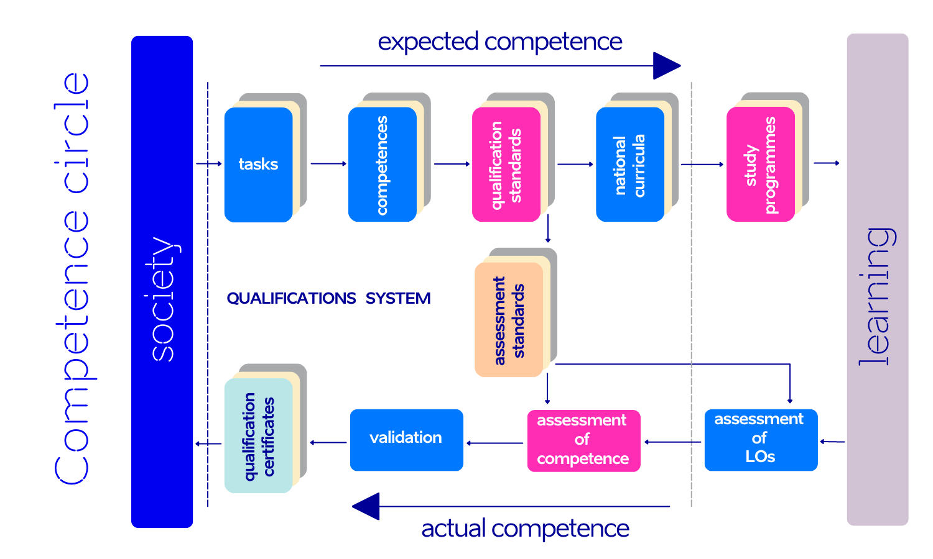
Graph: Estonian Qualifications Authority

Slide 4
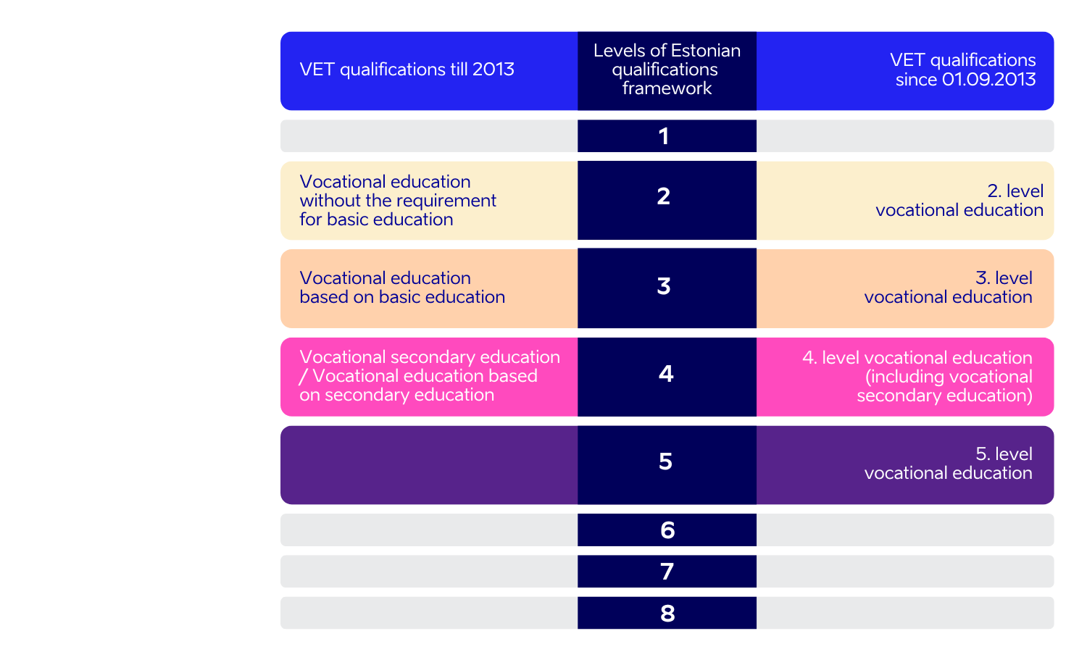
Qualification framework
Notes:
Biggest share of students are studying at the level 4
Vocational secondary education gives access to higher education (level 6)

Slide 5
Vocational Education and training in Estonia
At least one vocational education institution in every county
30
25 500
students
vocational education
institutions
25 state
3 private
2 municipal institutions
5
160
professional higher education institutions
specialities
Notes:
(Data: 2023) Vocational education can be acquired in vocational education centres. In few cases also in professional higher education institutions
Schools can be owned by state, local municipality or be based on private funds
Most of vocational education studies are school-based

Slide 6
Students
Notes:
Haridussilm, Oct 2023

Slide 7
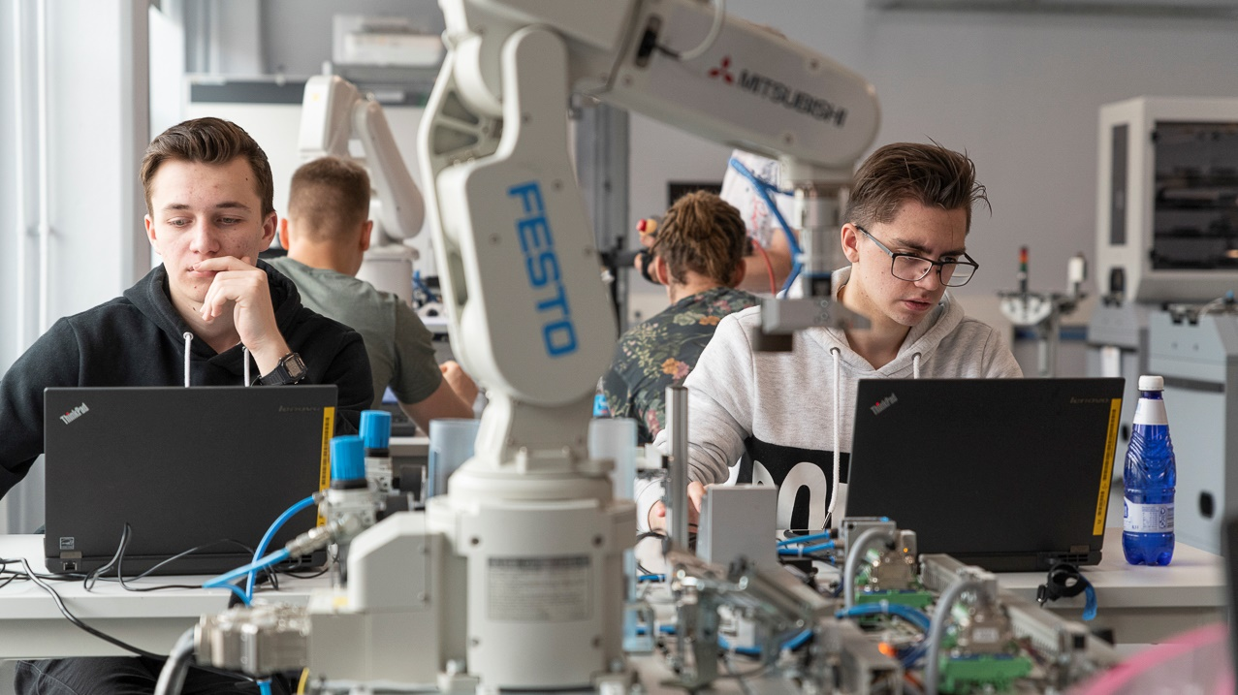
Quality assessment
Internal evaluations for quality control and improvement
External evaluations to align with national educational standards
Incorporating feedback from students and employers for curriculum development
Notes:
Internal and External Evaluations: Vocational schools undergo both internal and external evaluations to ensure quality. Internal evaluations are conducted by the schools themselves, focusing on continuous improvement. External evaluations are carried out by the Estonian Quality Agency for Higher and Vocational Education to ensure compliance with national standards.
Student and Employer Feedback: An essential part of the quality assessment process involves gathering feedback from both students and employers. This feedback is used to make necessary adjustments to the curriculum and teaching methods, ensuring that the education provided is both high-quality and relevant to the job market.
Source: HAKA - Hindamine

Slide 8
Meeting the needs of labour market
Workplace based studies
At least 2/3 of the curriculum is practical assignments in companies
Intern contract between the school, student and employee
The employee has to recompense the student for tasks performed. The wage must not be less than the statutory minimum wage

Slide 9
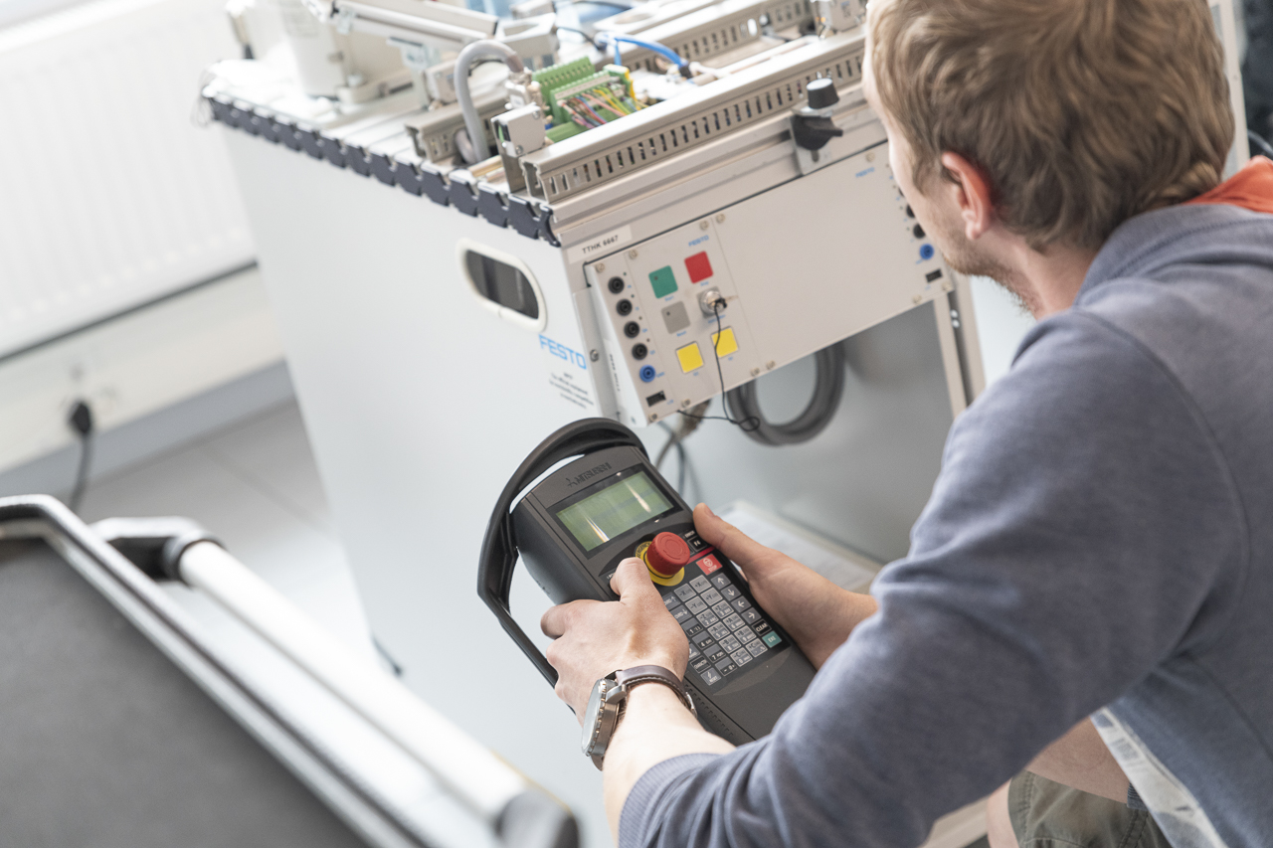
OSKA Coordination system for the monitoring and forecasting of the labour market needs
Answers to the following questions:
How many people and which skills are needed in our labour market today and tomorrow?
Where and how to aquire those skills?
What should be changed in today’s educational system and in lifelong learning system to meet the future needs?

Slide 10
OSKA
Based on the existing occupational qualifications system
The results of analysis are used as:
input to the qualification and career counselling system
curriculum development of educational institutions
financing of educational institutions (allocation of study places)

Slide 11
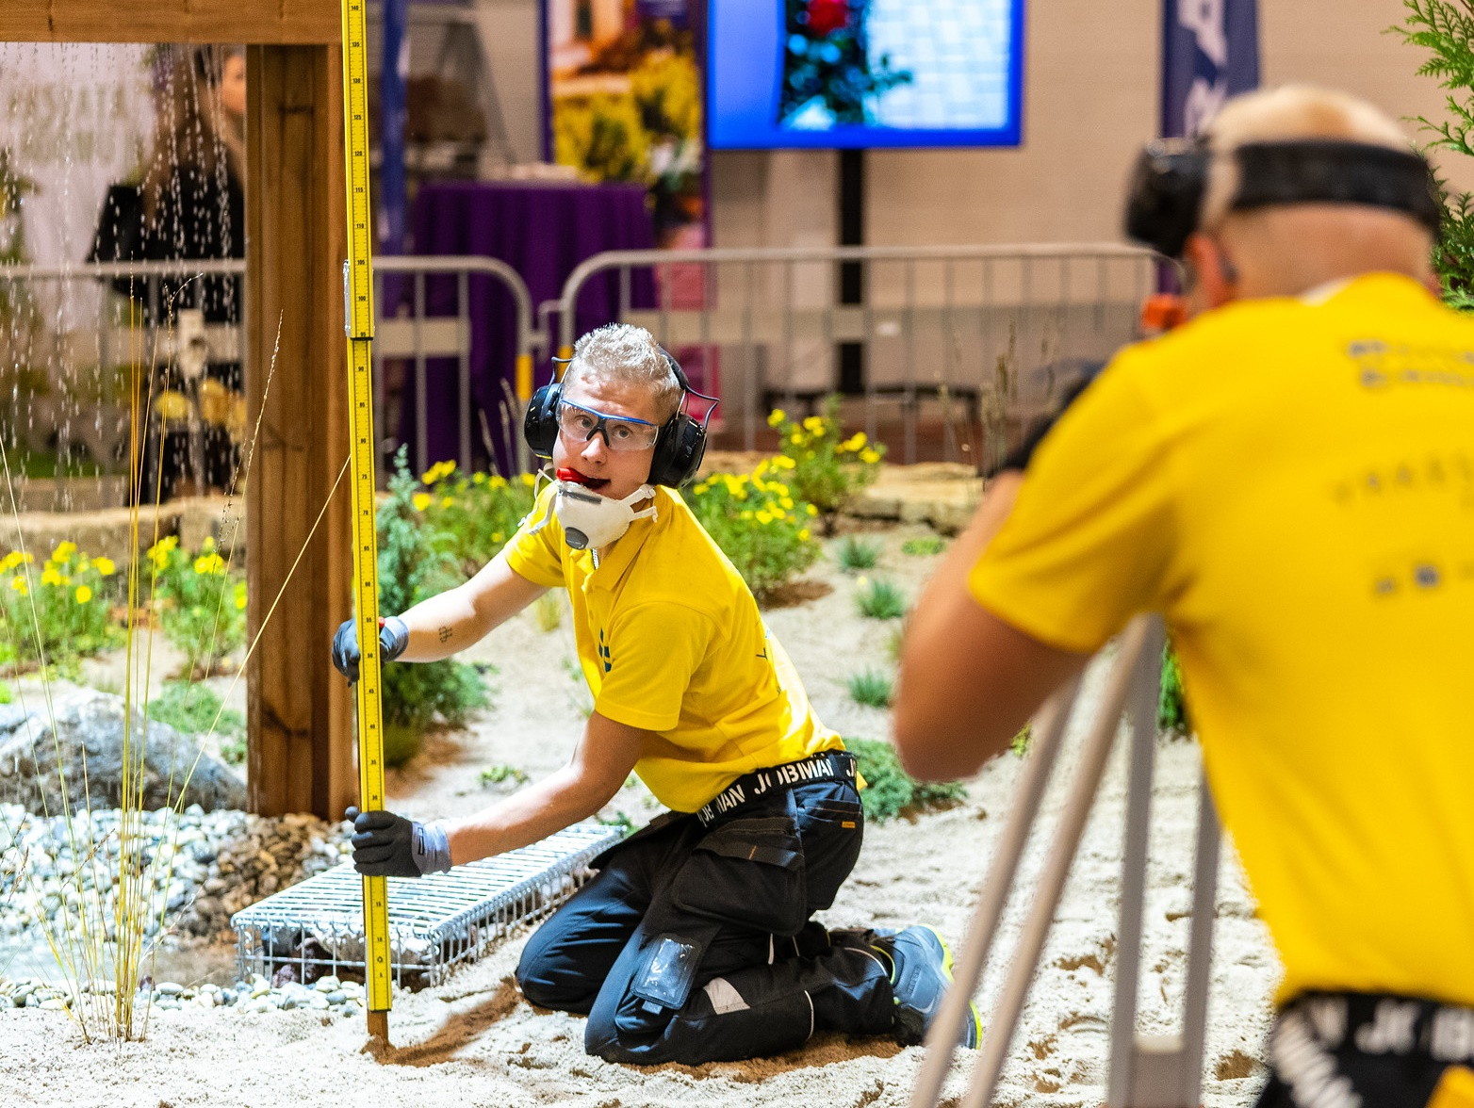
Contests for skill-building
Offering students the chance to test and develop their skills in a professional environment
Enhancing the attractiveness of vocational fields among young people
Strengthening Estonia's international reputation in vocational education through successful participation in global competitions
Notes:
Märkused:
Skill development and assessment: Competitions offer students an invaluable opportunity to put their skills to the test, develop them further, and have them assessed in a professional setting. These competitions highlight the practical value of vocational education and help students gain a deeper understanding of the demands and opportunities associated with their chosen fields.
Popularising vocational education: Competitions such as "Noor Meister" and other international skills contests serve to elevate the status of vocational education. They play a crucial role in making vocational fields more appealing to young people, thereby boosting enrolment rates.
International collaboration: International platforms like EuroSkills and WorldSkills offer a venue for global cooperation. They provide Estonian students and educators with the opportunity to interact with and learn from their counterparts in other countries. Success in these international arenas serves to enhance Estonia's reputation in the field of vocational education on a global scale.

Slide 12
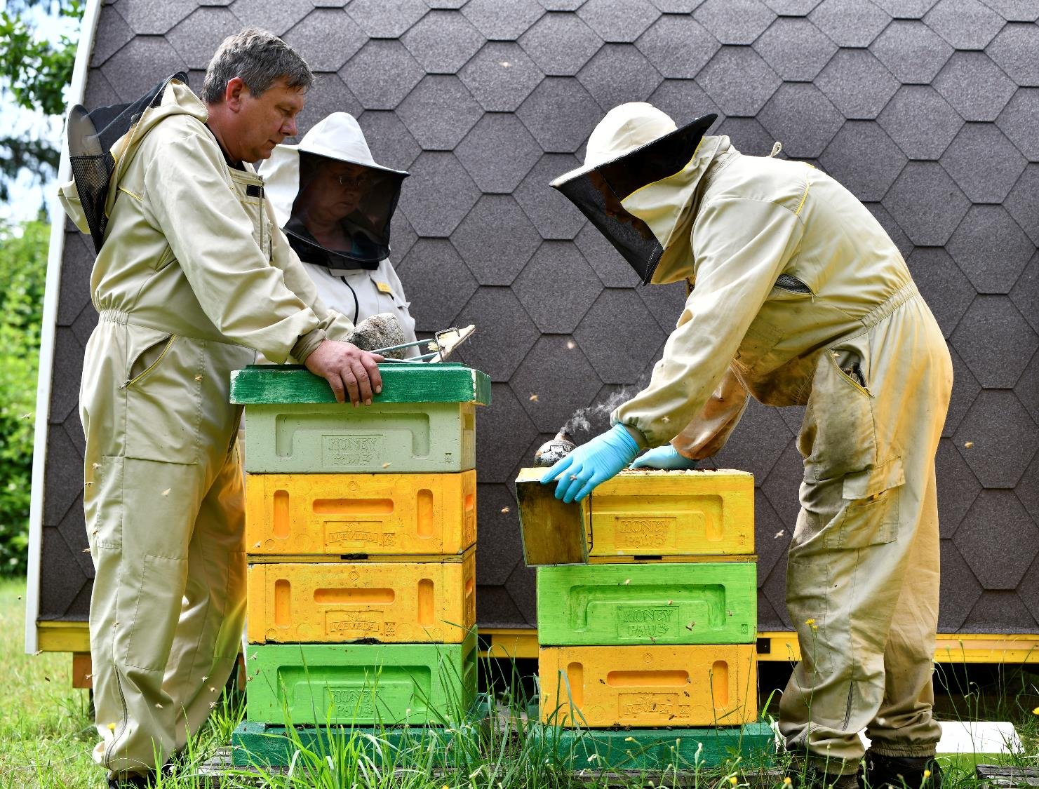
Aitäh!
Photos: WorldSkills, Küllike Heide, Lauri Kadajane, Marek Metslaid
educationestonia.org/vet
Notes:
12

Slide 13
Read me!
To make your presentation look good, make sure you have the official Estonia Aino font installed. If not, download and install the font separately HERE.

