Slide 1
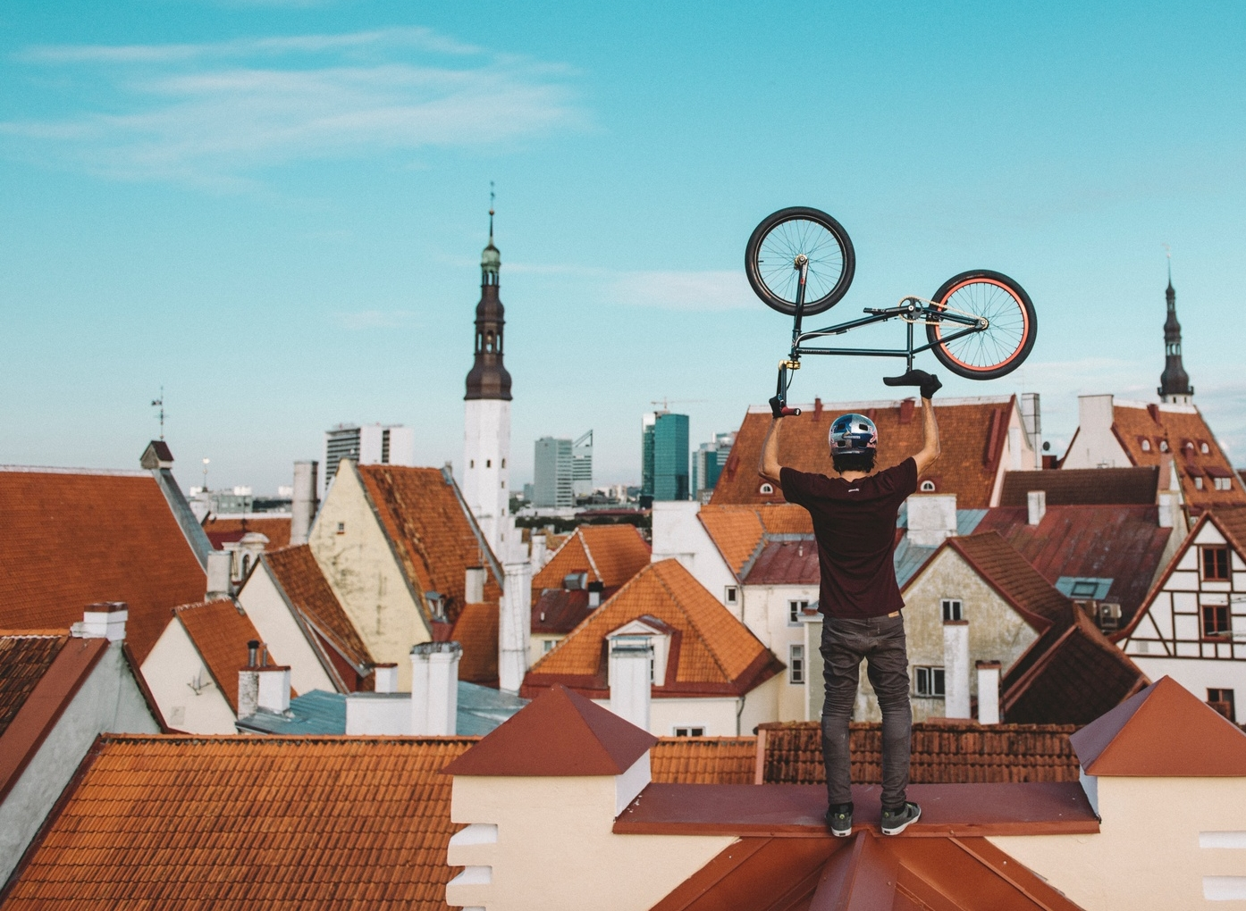
Empowering
Young People
An overview of Estonia’s youth sector
Notes:
1

Slide 2

Snapshot of Estonian young people
The age range for youth in Estonia is defined as 7 to 26 years
60%
10%
21%
of Estonia’s population
engaged in
youth work
NEET
youth
90%
*288,117 individuals
(2023)
14%
satisfied with
youth work
youth
unemployment

Slide 3
Youth sector in Estonia. Main elements
State-coordinated but youth-driven
YOUTH INFORMATION PORTAL gathers crucial information on education, career, relationships, health, etc, and is widely used.
DIVERSE SUPPORT FOR YOUNG PEOPLE:
From tackling NEET challenges to special programmes for talented young people.
QUALITY OF YOUTH WORK is supported by
a quality assessment model actively used by local governments.
Estonia's youth sector's future is directed
by STRATEGY 2035, developed in collaboration with all stakeholders.
Young people have a say in decisions
that affect them: VOTING RIGHTS START AT AGE 16 in local elections.
The rights of STUDENT and YOUTH COUNCILS are enshrined in law.
HOBBY EDUCATION has its own curricula, providing broad
self-development options in areas like music, arts, sports and technology.
With three Bachelor's and one Master's programmes, Estonia prioritises PROFESSIONAL YOUTH WORK EDUCATION.

Slide 4
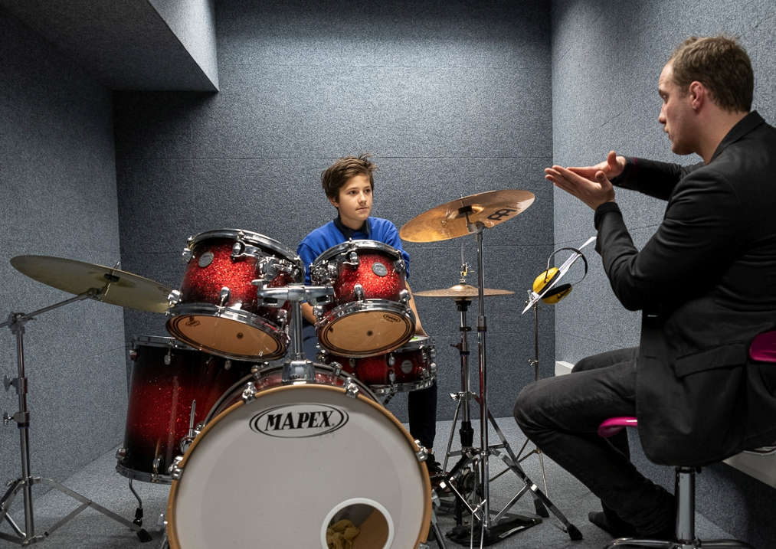
80% of the 7-19 year-olds participate in hobby schools or hobby activities
Notes:
Allikas:

Slide 5









Hobby activities
Youth projects
Many engage in hobbies
in schools, youth centres,
and youth associations.
Youth meetings, youth initiatives,
Erasmus+ & European Solidarity Corps participants
Formats &
structures for
youth sector
activities
Hobby education
Youth associations
16% of all Estonian young
people belong to youth associations and
organisations
Over 800 hobby schools.
53% of 7-16 year-olds and
10% of 17-26 year-olds attend
Open youth centres
Support for NEET young people
281 open youth centres all over Estonia provide safe space for youth and 28% of Estonian youth attend.
Youth work services
in local municipalities
Work camps
Youth participation
Youth camps
County and local youth councils, action groups, and student councils
Multiple organisers,
thousands of participants
11% of Estonian young
people participate

Slide 6

What we stand for
Core principles of Estonia's youth sector
Recognising the unique needs of young people
Understanding and informing about youth issues
Upholding youth autonomy and rights
Treating young people as equal partners
Promoting active and meaningful youth inclusion
Fostering youth development and self-realisation
Valuing every individual young people

Slide 7
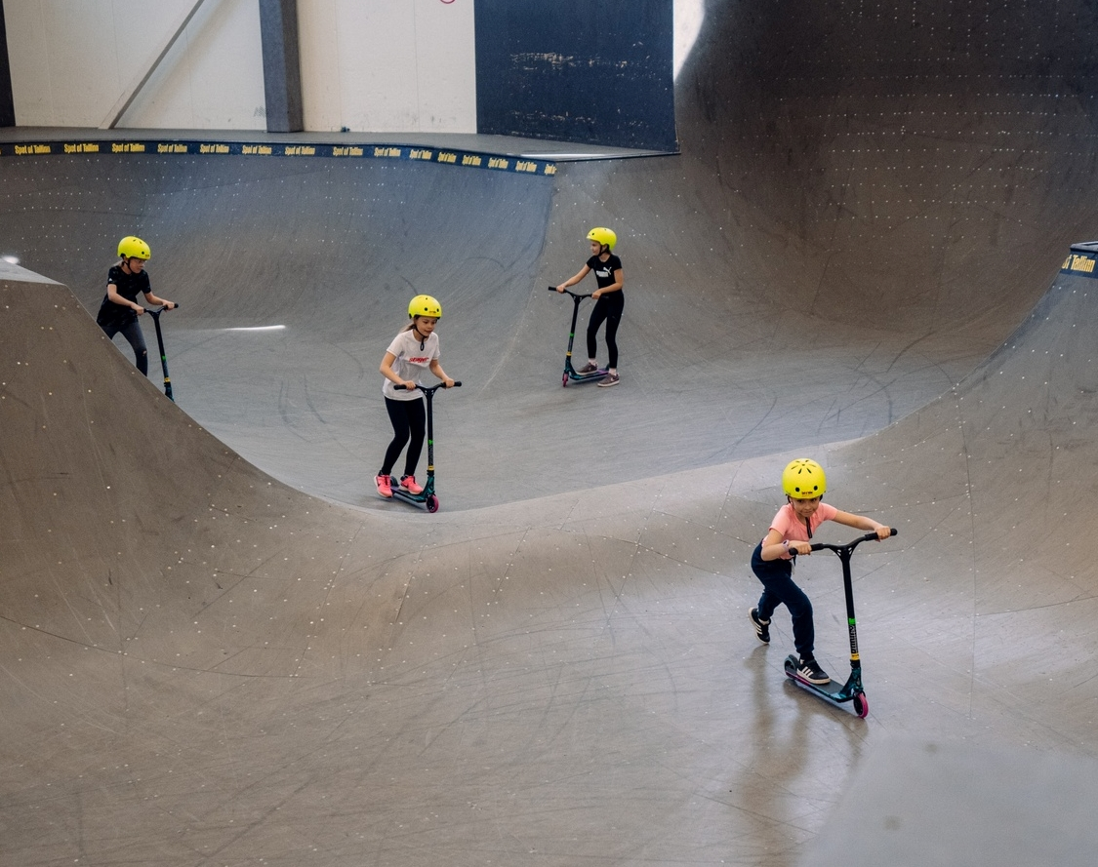
Challenges & future tasks
Challenges:
Declining youth population due to ageing society
Inaccesibility of services for young people in rural areas
Lack of qualified staff due to low salary
No formal training available for hobby education instructors
Next steps:
Introducing mandatory qualification requirements for youth sector workers
Integration of non-formal and formal education

Slide 8
Coordinating youth activities
MINISTRY OF EDUCATION AND RESEARCH
EDUCATION AND YOUTH BOARD
Youth and Talent Policy Department
Erasmus+
& European Solidarity Corps Agency
Youth Department
Develops national youth policy
Prepares legislation and regulations
Develops national youth programmes
Implements national youth policy
Implements European youth programmes in Estonia
Notes:
The Ministry of Education and Research oversees youth policy and youth work in Estonia, implemented through the Education and Youth Board of Estonia. Local authorities, being closest to the youth, plan objectives, activities, and allocate funds at the local level.

Slide 9



Monitoring & analysis
DATA
GOVERNANCE
QUALITY AND IMPACT ASSESSMENT
RESEARCH AND DEVELOPMENT
Data management
and data literacy
Continuous monitoring
of youth services
Research & innovation
of youth services
Data availability
Awareness and literacy
Clear, reusable data
Systematic and coordinated
data collection
Quality & impact description
Results documentation
Assessment and analysis tools
Monitoring trends
Original research
Research-based
application
Data-driven innovation
& new data sources
Development of higher education and research
Notes:
https://api.hp.edu.ee/sites/default/files/inline-files/Youth%20Monitoring%20and%20Analysis%20System%20Estonia.pdf

Slide 10
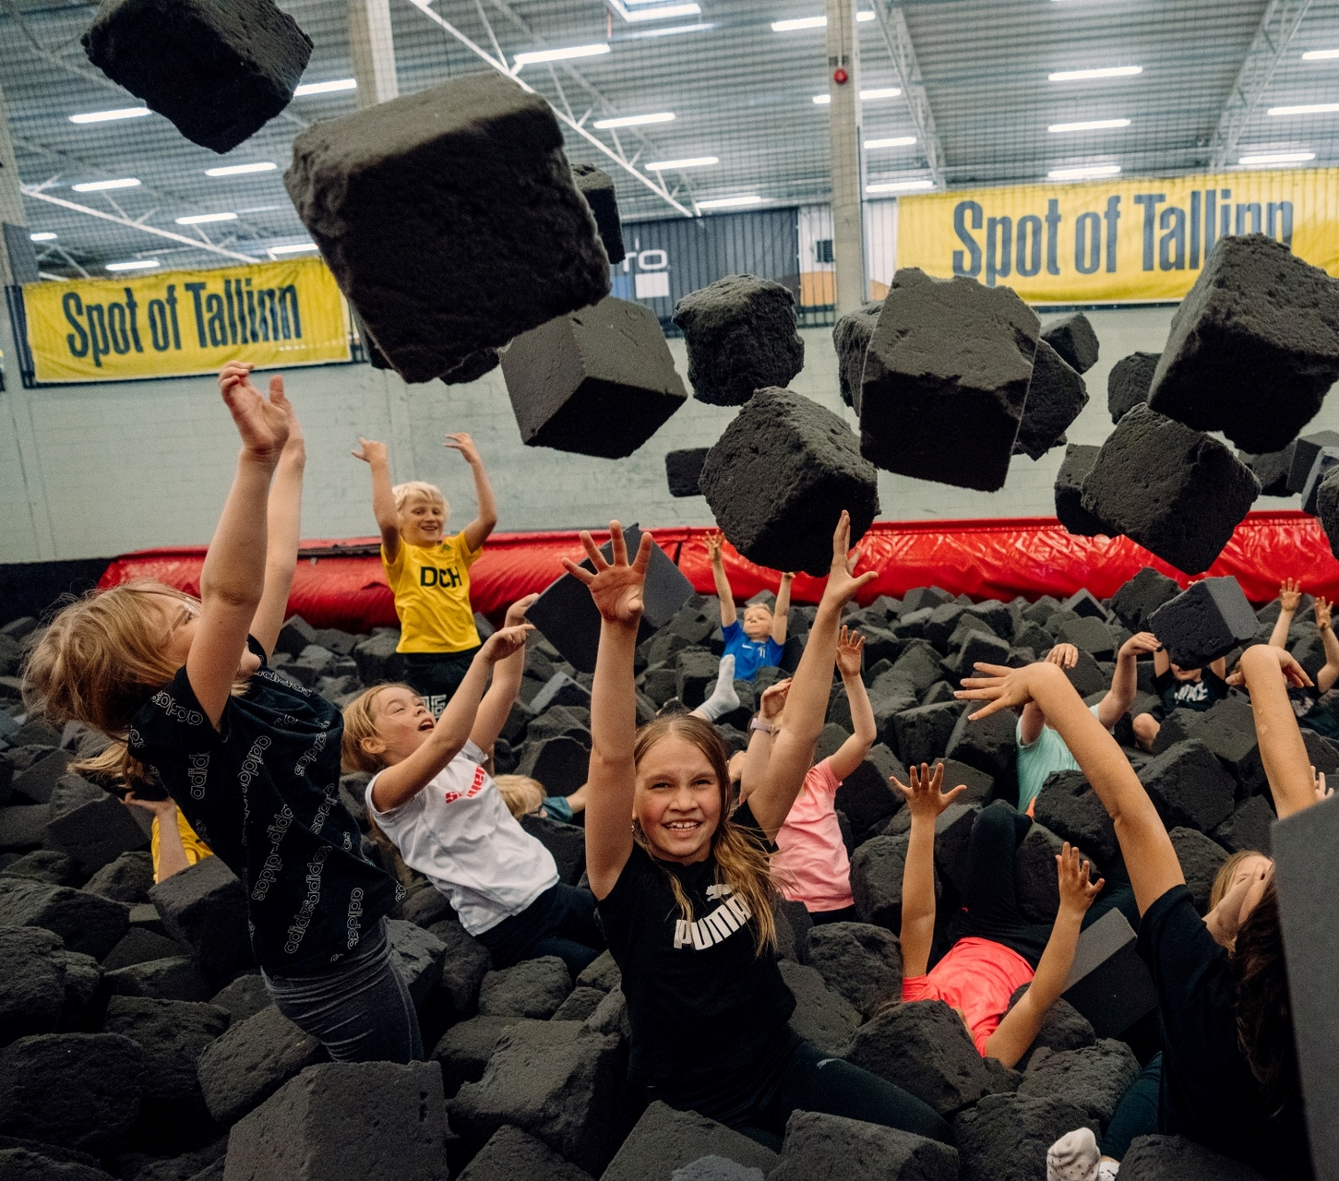
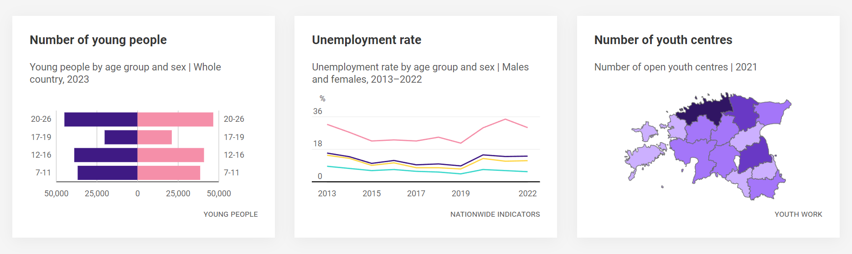
Youth data
How Estonia keeps track
Youth Monitoring is a central system for youth data, managed by the Ministry and Education and Youth Board
Co-operation with universities for research and improvements in youth work
The Youth Monitoring Dashboard and periodic reports provide a detailed view of youth demographics and activities.
juhtimislauad.stat.ee/en/youth-monitoring-6

Slide 11

Shaping the future
Strategic aims of the Youth Sector Strategy 2021–2035
MOMENTUM
Empowering youth as the creative force in society, focusing on education, culture, and economy.
RIGHTS AND PARTICIPATION
Ensuring consistent protection of youth rights and encouraging active civic participation.
QUALITY YOUTH WORK
Making quality youth work accessible across Estonia for versatile self-development.
SAFETY NET
Identifying and preventing youth exclusion through a supportive network.

Slide 12



Our goal is to build
Estonia that young people want to live in and lead
Metric: Increase young people’s trust in state
In 2022, 57% of young Estonians
expressed trust in the parliament.
Our 2035 aim is 70%
Estimated cost over 15 years: €356 million
70%
57%
Notes:
12

Slide 13

Aitäh!
Photos: Liina Notta. Küllike Heide,
Hans Markus Antson, Sven Zacek, Renee Altrov, Aron Urb
Notes:
13

Slide 14

Read me!
To make your presentation look good, make sure you have
the official Estonia Aino font installed.
If not, download and install the font separately HERE.

