Slide 1
Eesti. Lood ja faktid
Eestit tutvustav esitlus
Esitlus on mõeldud kõigile, kel tuleb töö- või õppereisidel Eestist rääkida.
Täienda oma lugudega. Me kõik oleme Eesti saadikud.

Slide 2
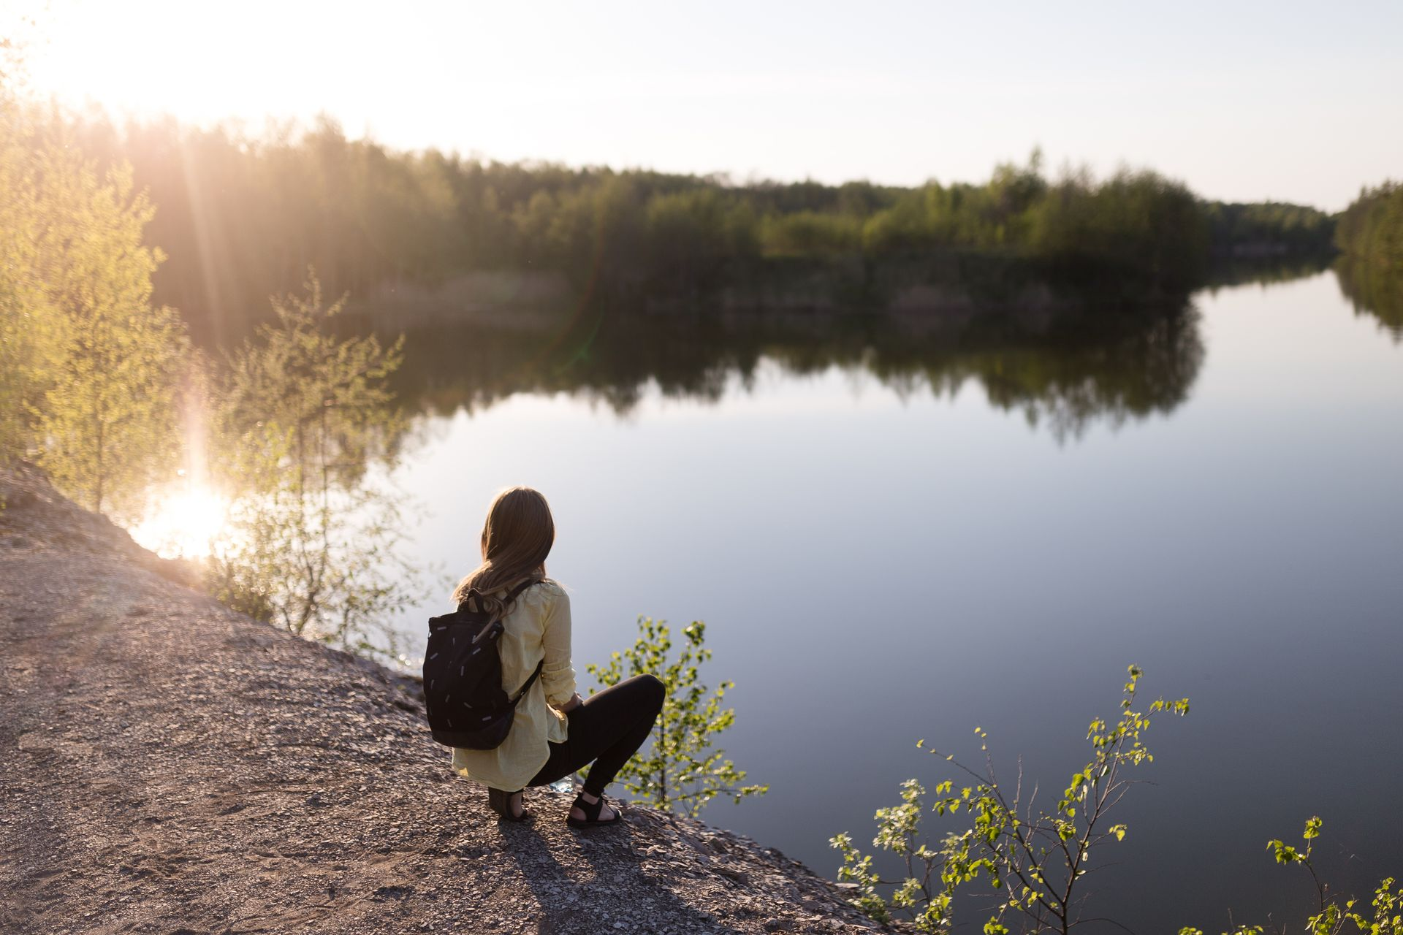
Estonia.
Facts and Tales

Slide 3

Estonia
population: 1.36 million
area: 45,335 km²
currency: Euro
member of EU, NATO from 2004

Slide 4


Estonia
18h
#6
Daylight in summer
The first country in the world to vote online
Among top countries for press freedom
Cleanest air in the world ranking
Notes:
Find more rankings at facts - Brand Estonia

Slide 5
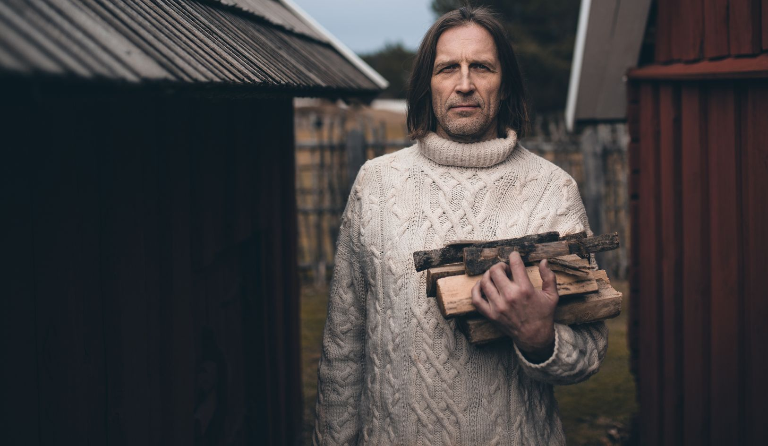
Estonians
You never know if we are happy or sad.
Or angry. Or excited. Most Estonians, including customer servants,
hide their emotions extremely well.

Slide 6
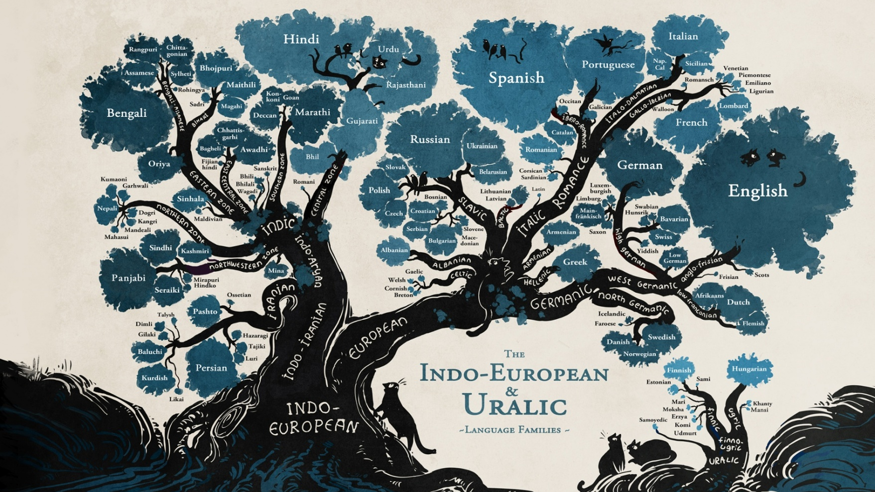
Minna Sundberg

Slide 7
öö
töööö
jäääär
Ulata õlu üle Ülo õe õla

Slide 8
Estonia values education
PISA 2022: Estonian students lead in Europe and worldwide
1st in science
1-2 in reading with Ireland
1-2 in mathematics with Switzerland
 | MATHEMATICS |  | READING |  | SCIENCE
1 | Estonia | 510 | Ireland | 516 | Estonia | 526
2 | Switzerland | 508 | Estonia | 511 | Finland | 511
3 | Netherlands | 493 | UK | 494 | Ireland | 504
4 | Ireland | 492 | Finland | 490 | Switzerland | 503
5 | Belgium | 489 | Denmark | 489 | Slovenia | 500
6 | Denmark | 489 | Poland | 489 | UK | 500
7 | UK | 489 | Czech Republic | 489 | Poland | 499
8 | Poland | 489 | Sweden | 487 | Czech Republic | 498
9 | Austria | 487 | Switzerland | 483 | Latvia | 494
10 | Czech Republic | 487 | Italy | 482 | Denmark | 494

Slide 9
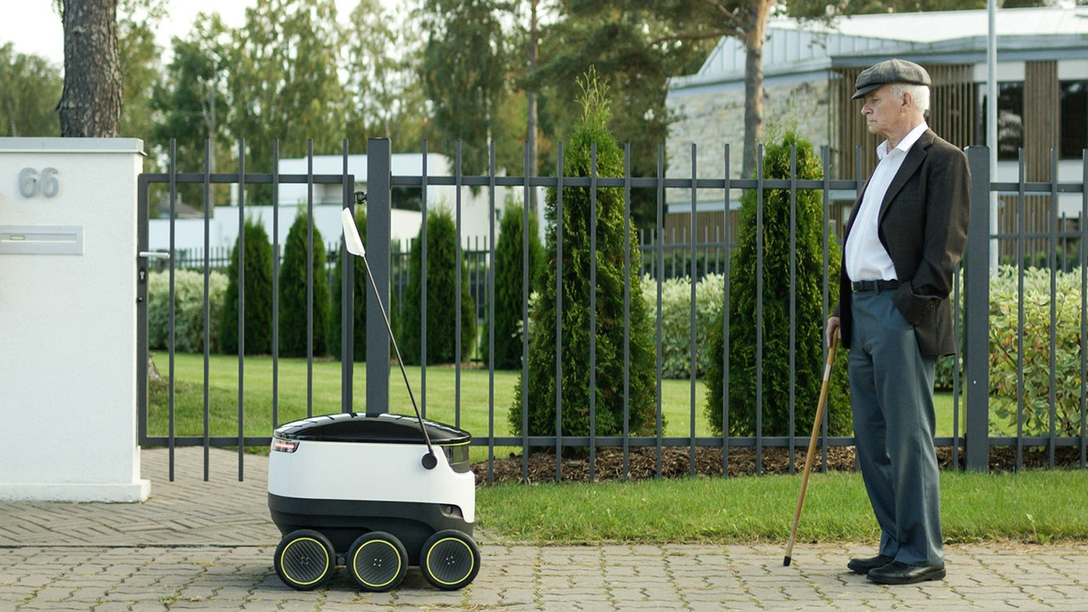
100% public services available online 24/7
3 min to fill taxes
Notes:
We are committed to designing solutions that anticipate change and tackle pressing societal issues including environmental sustainability and AI readiness. Our legal framework supports the testing and validating of innovative ideas – such as self-driving cars or personal pickup lockers – before widespread implementation. We innovate and refine through structured experimentation, preparing for future challenges and opportunities.
We have created the ideal testing ground, welcoming trailblazing ideas from everywhere.
Our future-proof tomorrow is built on a top-tier education system, a business-friendly environment, and innovative thinkers.
Related facts:
Estonia is hailed as the world’s most advanced digital society. The innovative mindset is evident in the digitised services and solutions: from world-leading ICT to sustainable wood and food industries.
Estonia is known for a result-driven mindset – the digital environment supports us being the perfect test bed to try out new ideas and fail fast at minimum cost.
Estonia is a world leader in unicorns per capita, counting 10 today and hopefully more in the future.
Naturally, digital integration has also extended into education. Since the e-diary platform eKool launched in 2002, a myriad of e-solutions, state-sponsored and private, have made the learning experience more accessible. Estonian EdTechs are fuelled by an entrepreneurial spirit and supported by research collaborations, which have earned them local and global recognition.
The blockchain technology KSI is designed in Estonia and used globally to ensure networks, systems, and data are compromise-free while retaining 100% data privacy. Estonia ranks as the #1 country to use blockchain nationally.

Slide 10
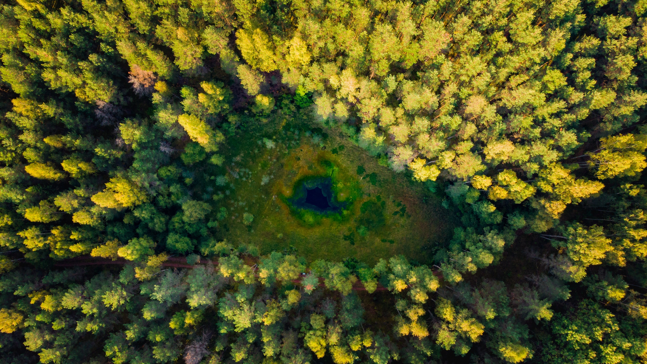

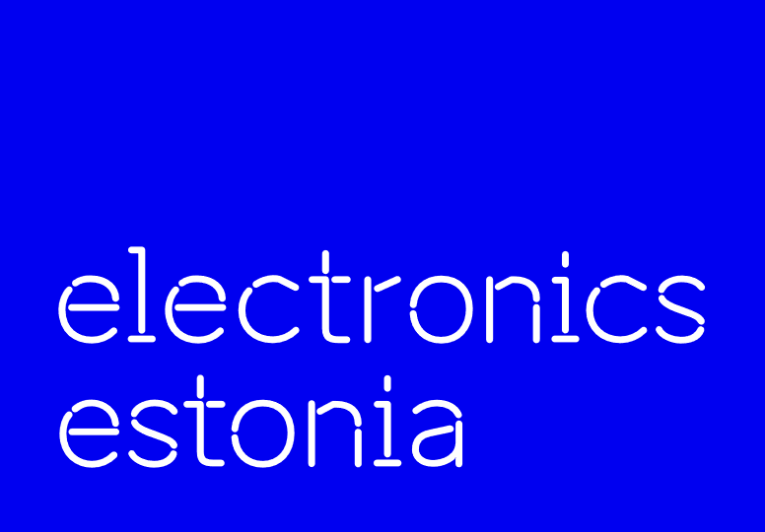


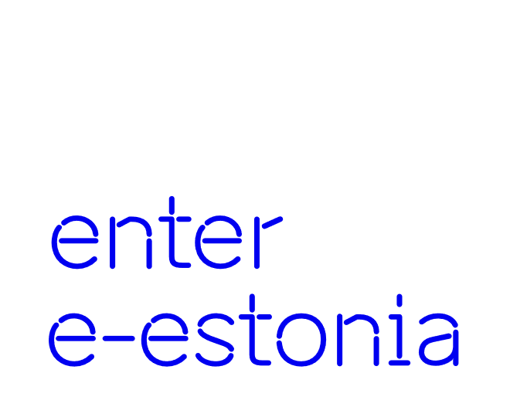
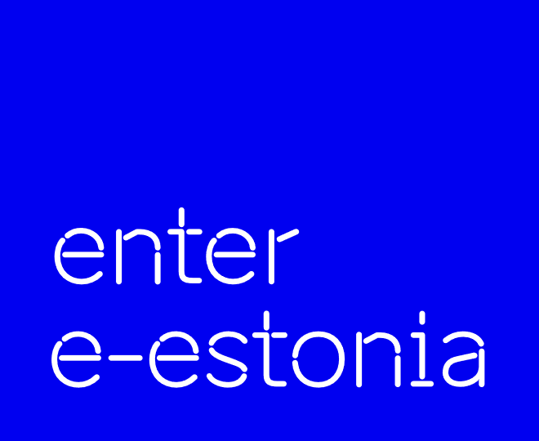





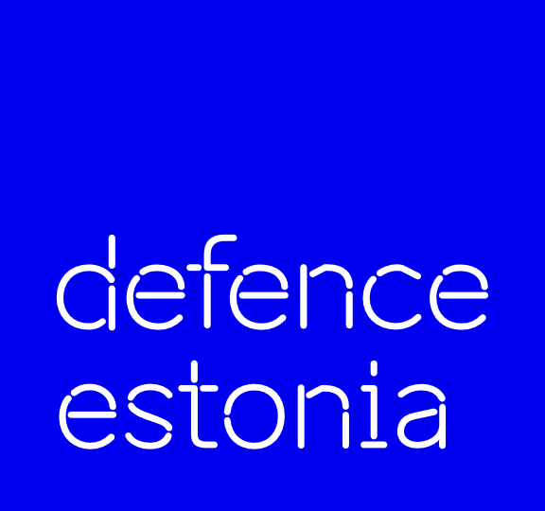


















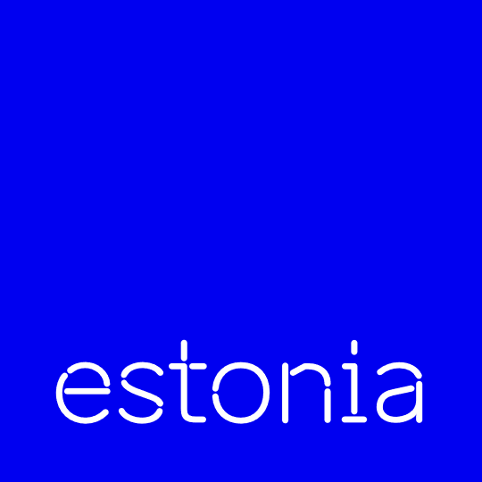
51% of Estonia is covered by forests
There is plenty of space.
Population density is 30.3 people per km² - 4 times less than EU’s average.

Slide 11
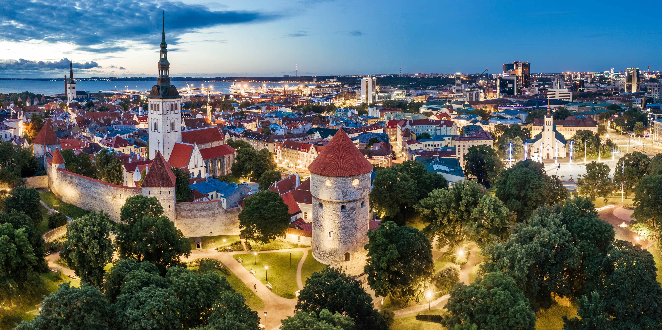
4th cleanest urban air quality in in the world. WHO

Slide 12
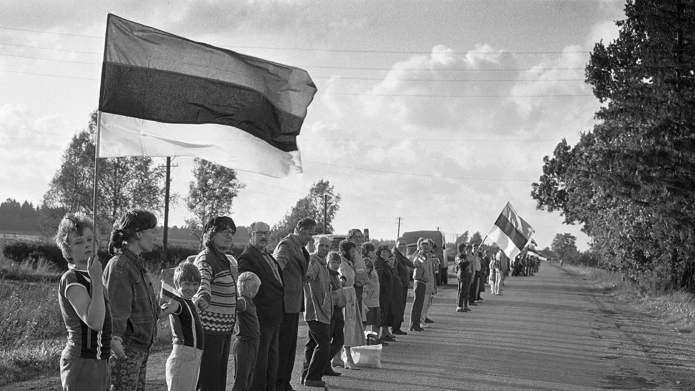
The Baltic Way
2 million people. 3 states. 690 kilometres
Notes:
UNESCO Memory of the World Register
23 August 1989. Approximately two million people joined their hands to form a human chain spanning 690 kilometres (430 mi) across the three Baltic states of Estonia, Latvia and Lithuania,

Slide 13
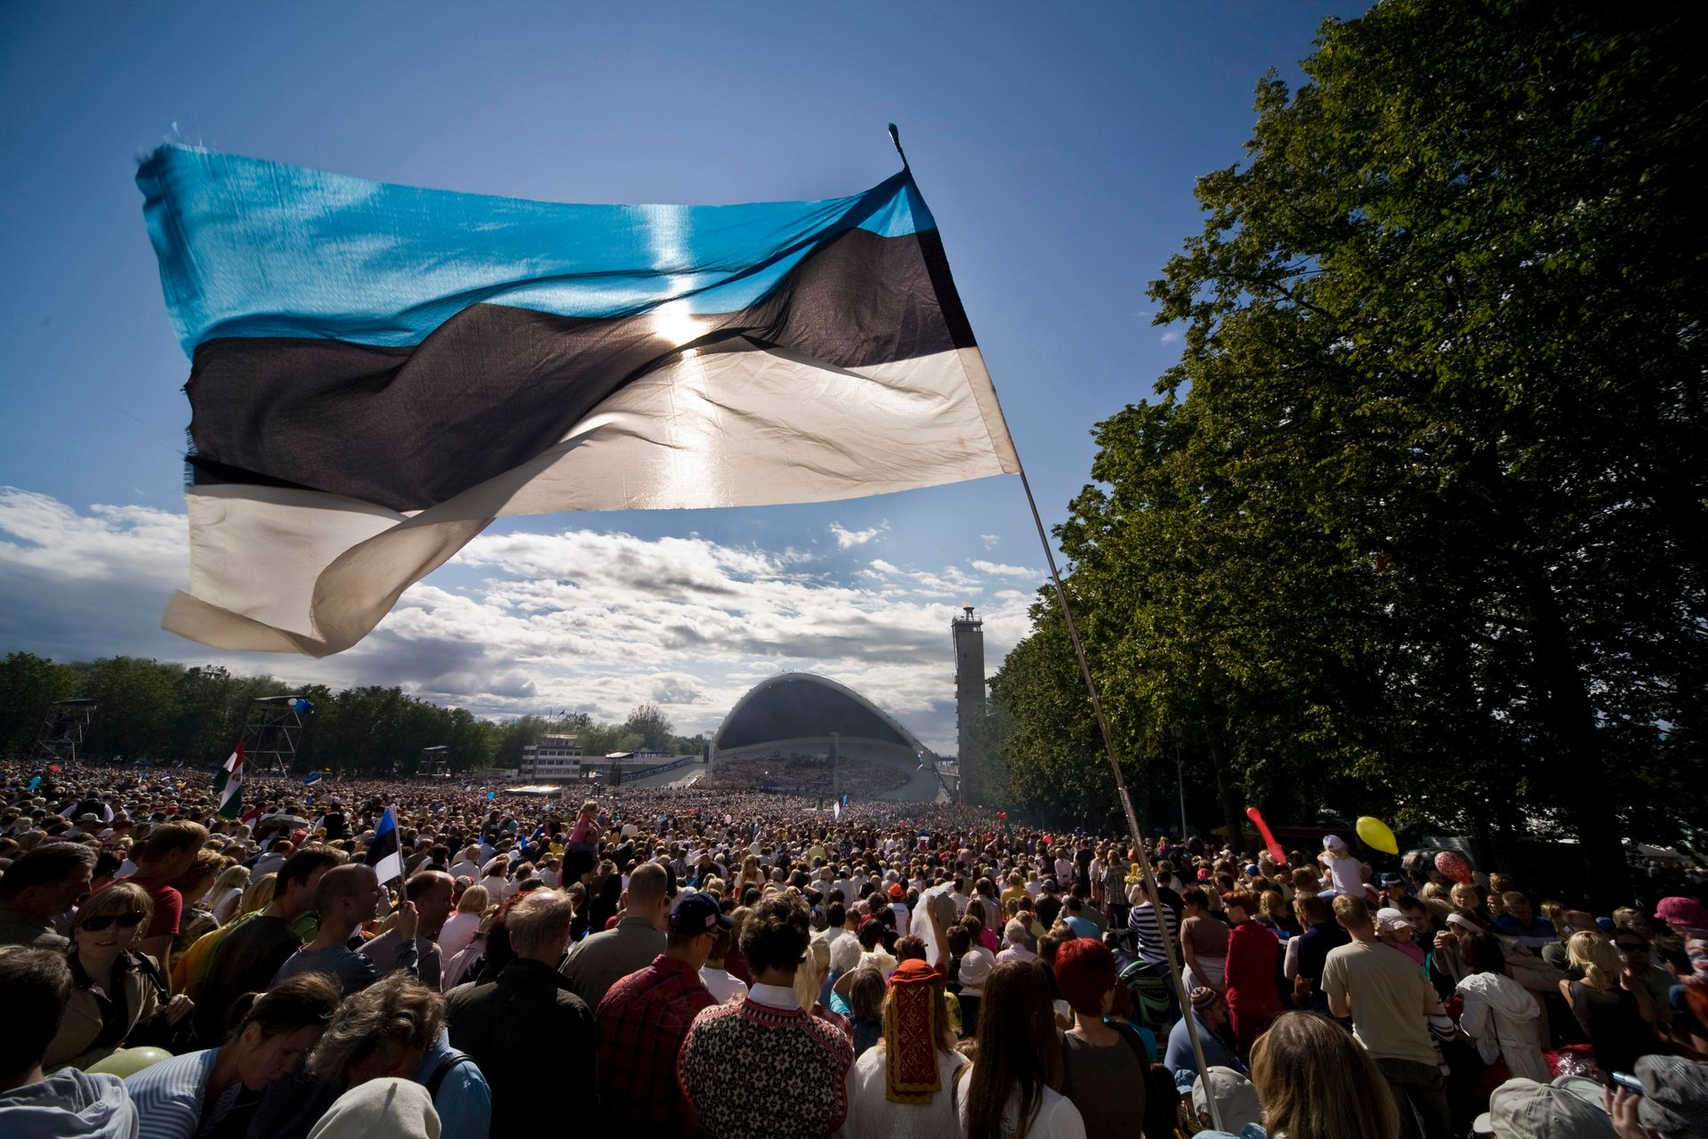
Song and dance festival
100,000 singers and dancers participate – almost every 10th Estonian.
Notes:
Estonian Song and Dance Festival - UNESCO World Heritage

Slide 14
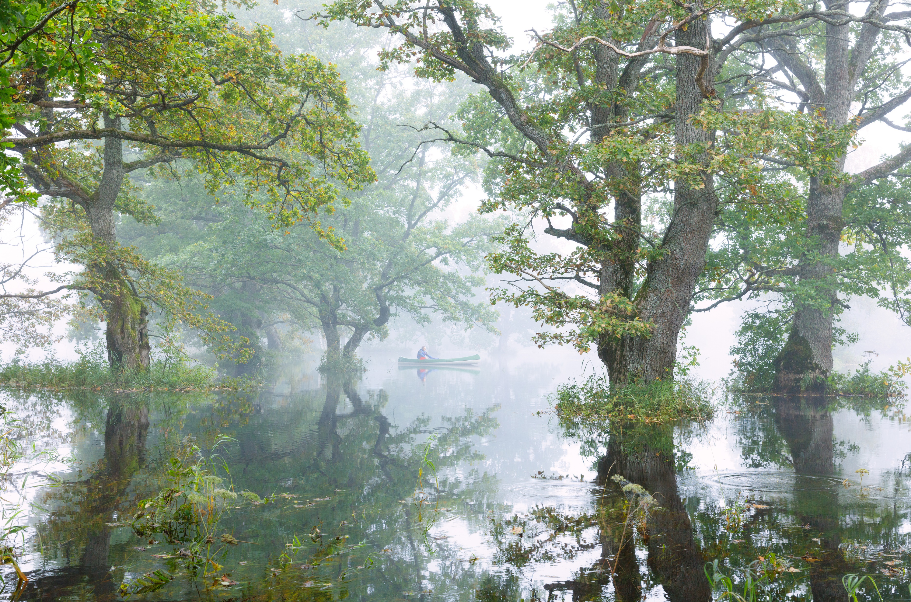
5th season
when You can paddle a canoe through the forest

Slide 15
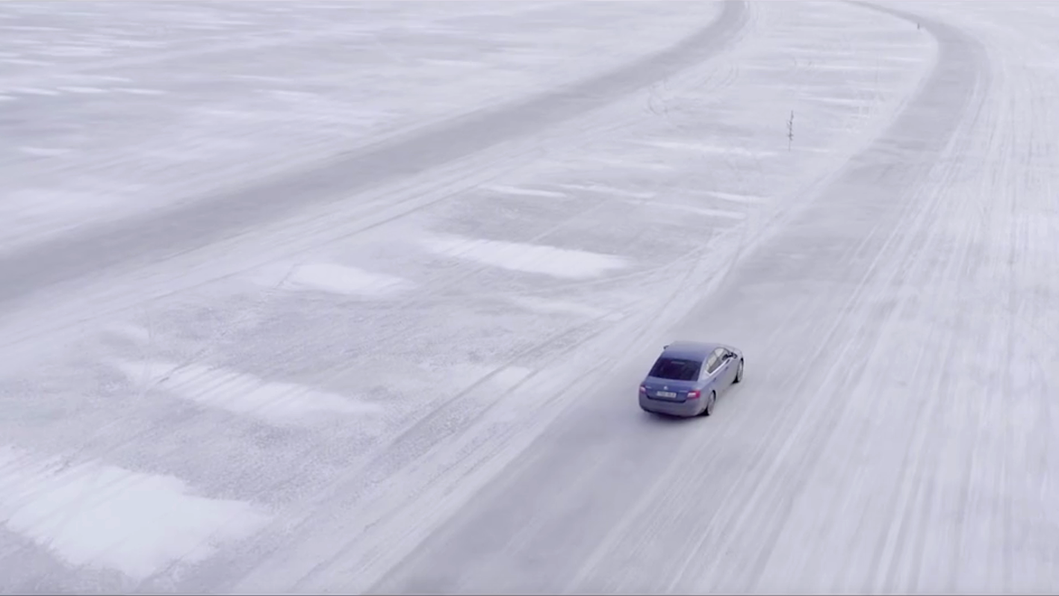
The longest ice road in Europe
Hiiumaa - Rohuküla, 27 km
Notes:
Hiiumaa - Rohükula, 27 km.

Slide 16
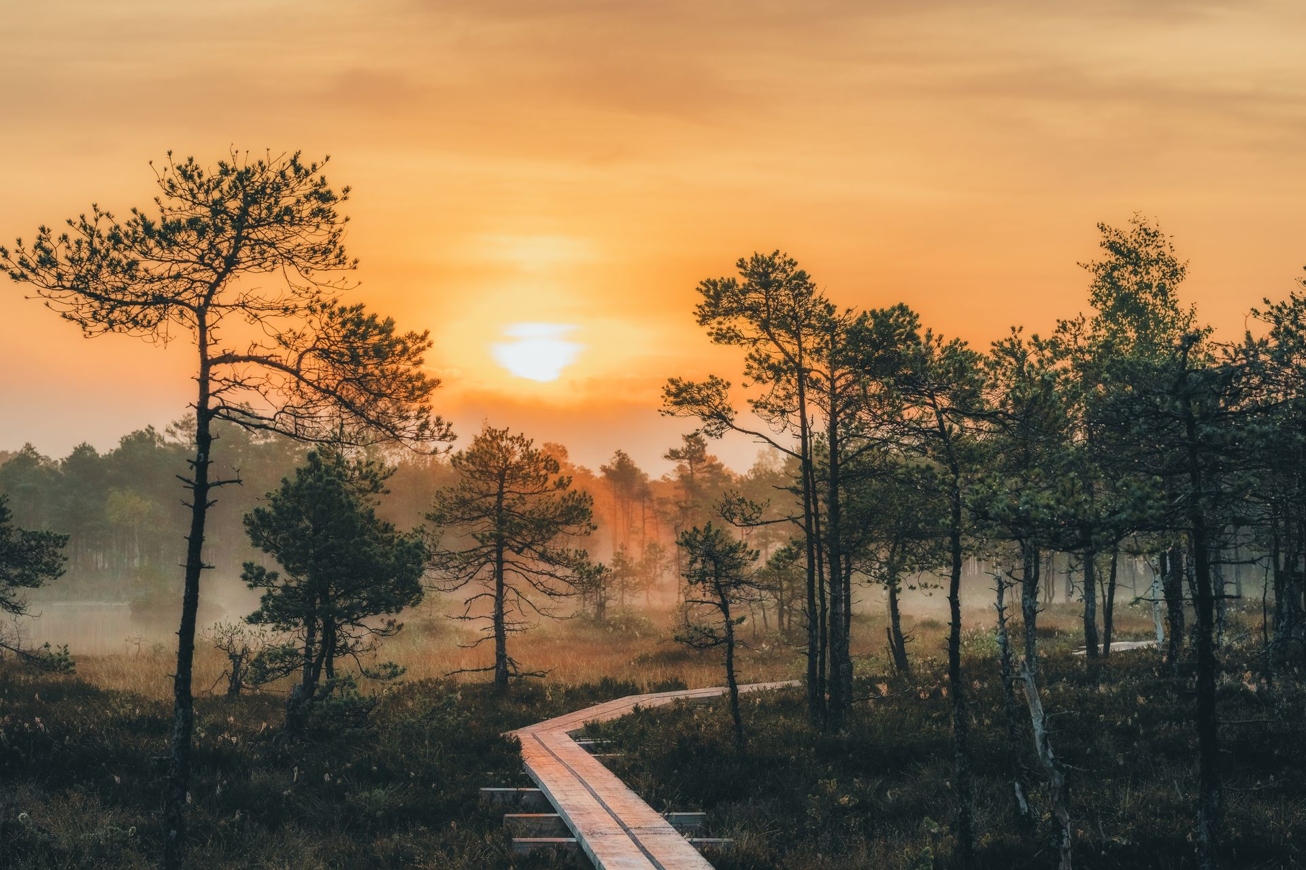
Aitäh!
Photos: Renee Altrov, Minna Sundberg, Kaupo Kalda, Priidu Saart,
Jarek Jõepera, Kaarel Mikkin, Jaan Künnap, Brand Estonia, Giulio Gröbert

Slide 17

Loe mind!
Et esitlus hea välja näeks, veendu, et sul on arvutis olemas Eesti font Aino.
Kui pole, laadi see alla ja installeeri arvutisse SIIT.

